Slide 1
Test Cases in the Aspen Institute Lecture by Aviv Regev
From Aspen Lecture: An Atlas of Human Cells, The Aspen Institute Channel

Slide 2
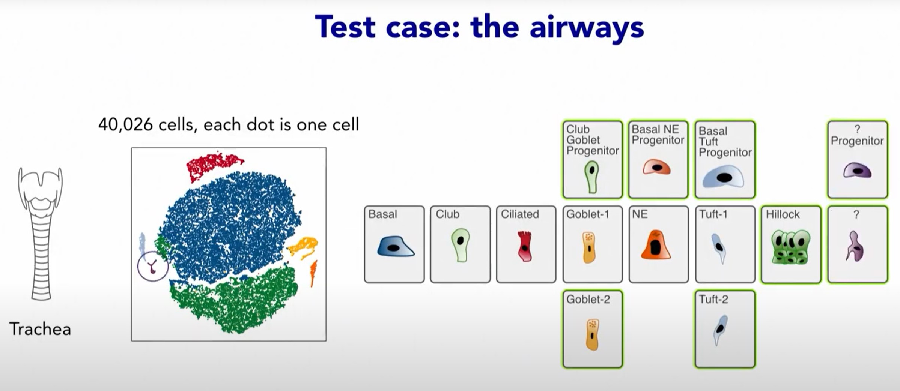
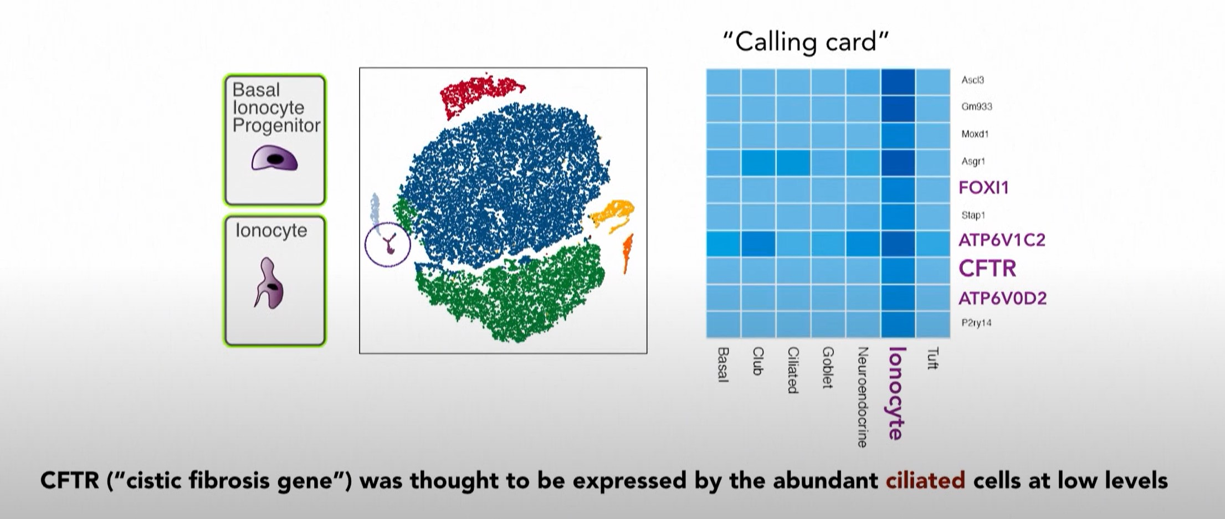
“Discover cell Types we did not know exist”
Before single cell RNA seq, researchers were aware of 6 types of cells in the trachea. After, researchers found more.
Couple of the new ones was unfamiliar to them. Some genes that are expressed a lot in these cells are, however, familiar. Turns out the cells are like Ionocytes commonly found in fish gills to maintain the ion balance.
One of the genes expressed a lot in these cells, CFTR, is susceptible to “Cistic Fibrosis“ and not so much in ciliated cells are thought before.
Colors in the tSNE chart in both the images are for cells grouped by similarity(“a cluster for a particular type of cell”)
Screenshots from Aspen Lecture: An Atlas of Human Cells from The Aspen Institute YouTube Channel

Slide 3
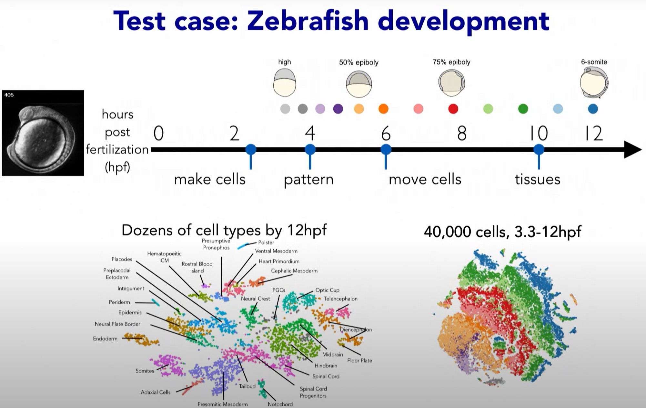
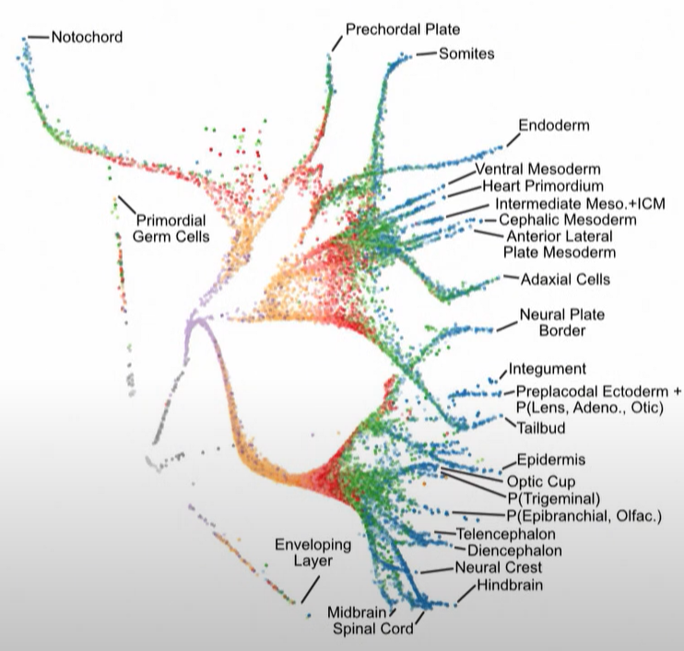
“Determine the Order of Cells Differentiation”
Labelled chart above is generated like before:
Every dot in the chart is a cell
Color is given by the algorithm by similarity
Combining the two:
Lineages of each cells all the way from the stem cell
Spatial information of the chart is yet to be understood.
Second chart difference:
Not colored algorithmically
Colored by time points in which the cells were collected
Timeline starts at the grey cells at the bottom of the chart
Screenshots from Aspen Lecture: An Atlas of Human Cells from The Aspen Institute YouTube Channel

Slide 4
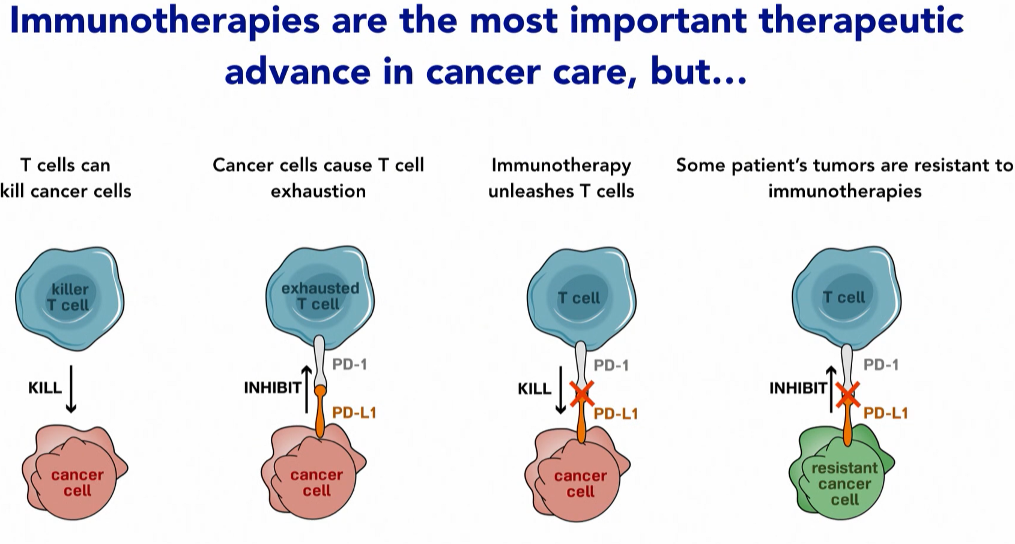
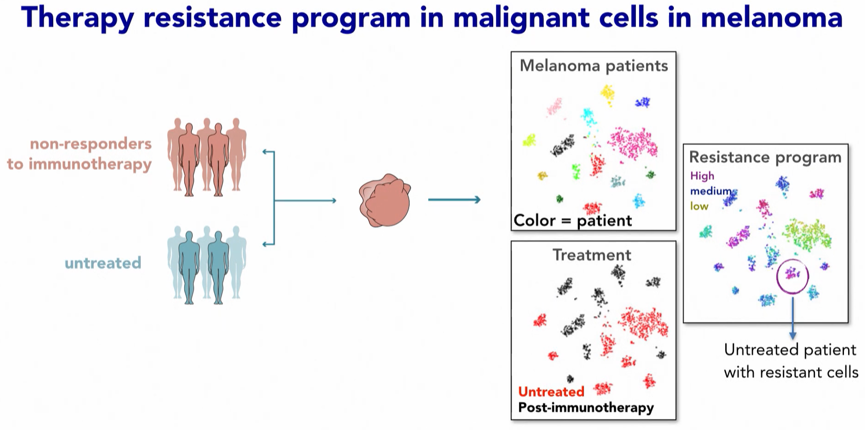
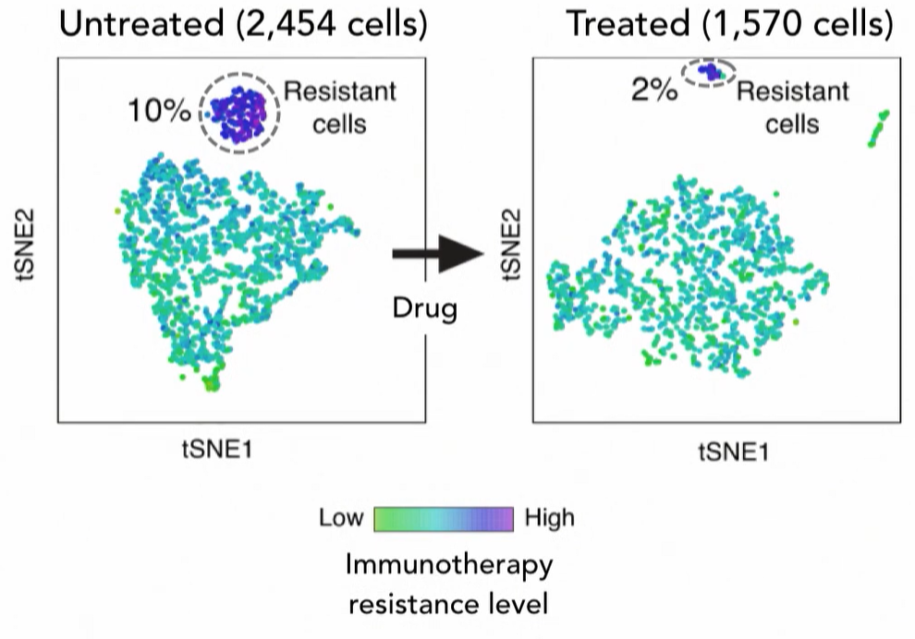
“Identify the Programs Cells use”
Cells need to adapt for different circumstances and stimuli.
T cells find cancer cells and kill them. But cancer cells can evolve to inhibit the T cells. They use processes in our body that turn off T cells (T cell exhaustion).
Treatment: Take the inhibition away.
Problem: Works for some patients and does not for others. Cancer cells activates the “T cell exhaustion” program one way or the other in these patients.
Solution: Find the program and stop it. Some patients may have the program activated before treatment, some during the treatment. We can predict if a treatment would work based on this. They find a different way to stop the program
Screenshots from Aspen Lecture: An Atlas of Human Cells from The Aspen Institute YouTube Channel

Slide 5
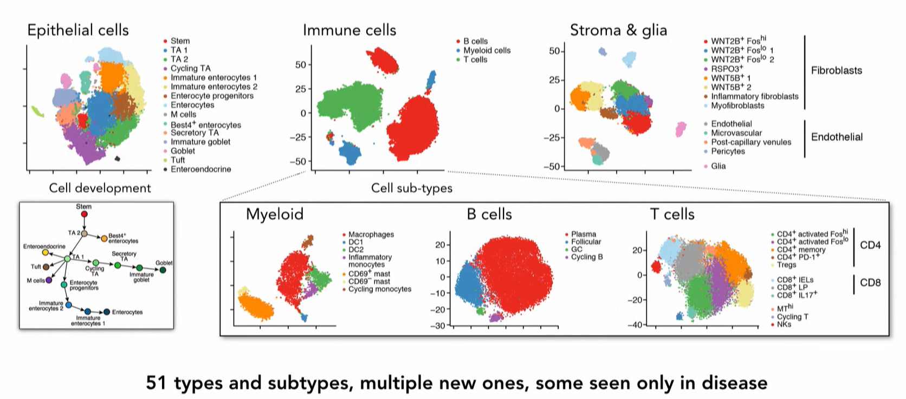
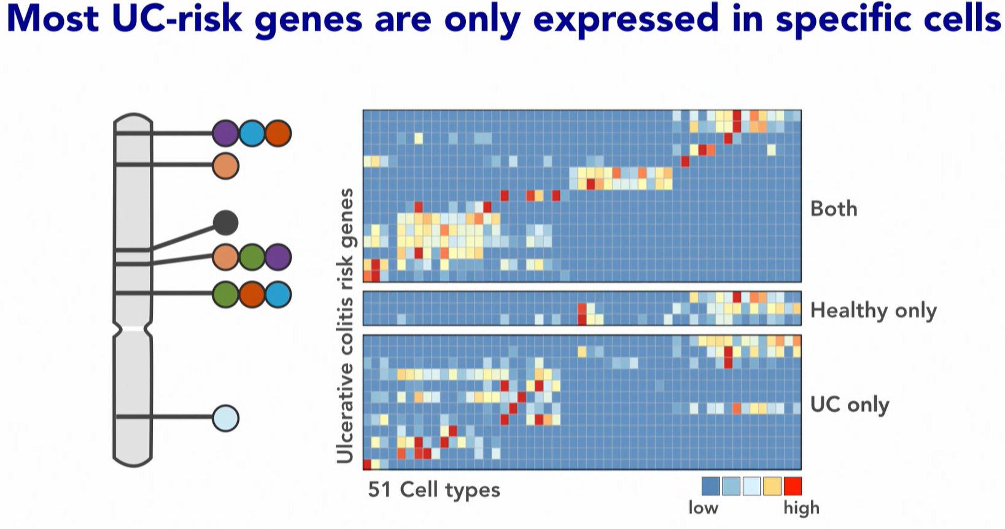
“Understanding the Basis and Treatment of Complex Genetic Disease”
So, in order to target those cells to develop therapy for UC, the gene expressions of the risky cells should be checked and compared with healthy cells.
M-like cells are found to expressed more in UC patients compared to healthy patients
For patients with Ulcerative colitis(UC), tissue cells are collected from the intestine and compared to healthy tissue cells from people without the disease.
The cells are mapped in the same was as the 1st Test case. Some cells are found in the patients which are not among the healthy cells like Inflam. Fibroblasts and M-like cells.

Slide 6
Papers used for the talk:
Test Case 1:
Test Case 2: https://www.ncbi.nlm.nih.gov/pmc/articles/PMC6247916/
Test Case 2 - Human Blood Cells : https://pubmed.ncbi.nlm.nih.gov/27124452/
Test Case 3: https://pubmed.ncbi.nlm.nih.gov/27124452/
Test Case 4: https://www.biorxiv.org/content/10.1101/455451v1
Diagrams in zebrafish generated using URD: https://github.com/farrellja/URD
URD is an R package designed for reconstructing transcriptional trajectories underlying specification or differentiation processes in the form of a branching tree, using single cell RNA-sequencing data.

Slide 7
Deep Dive Into the Test Cases
Test Case 3: “Identify the Programs Cells use”
Dissecting the multicellular ecosystem of metastatic melanoma by single-cell RNA-seq

Slide 8
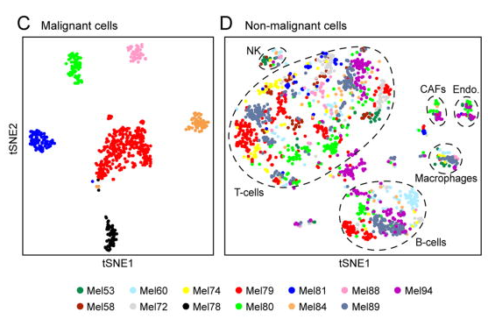
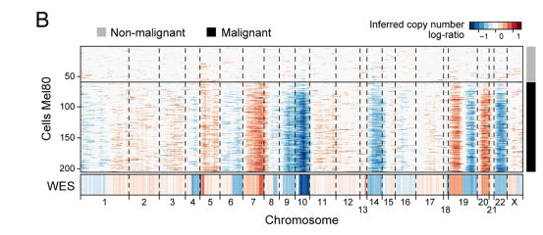
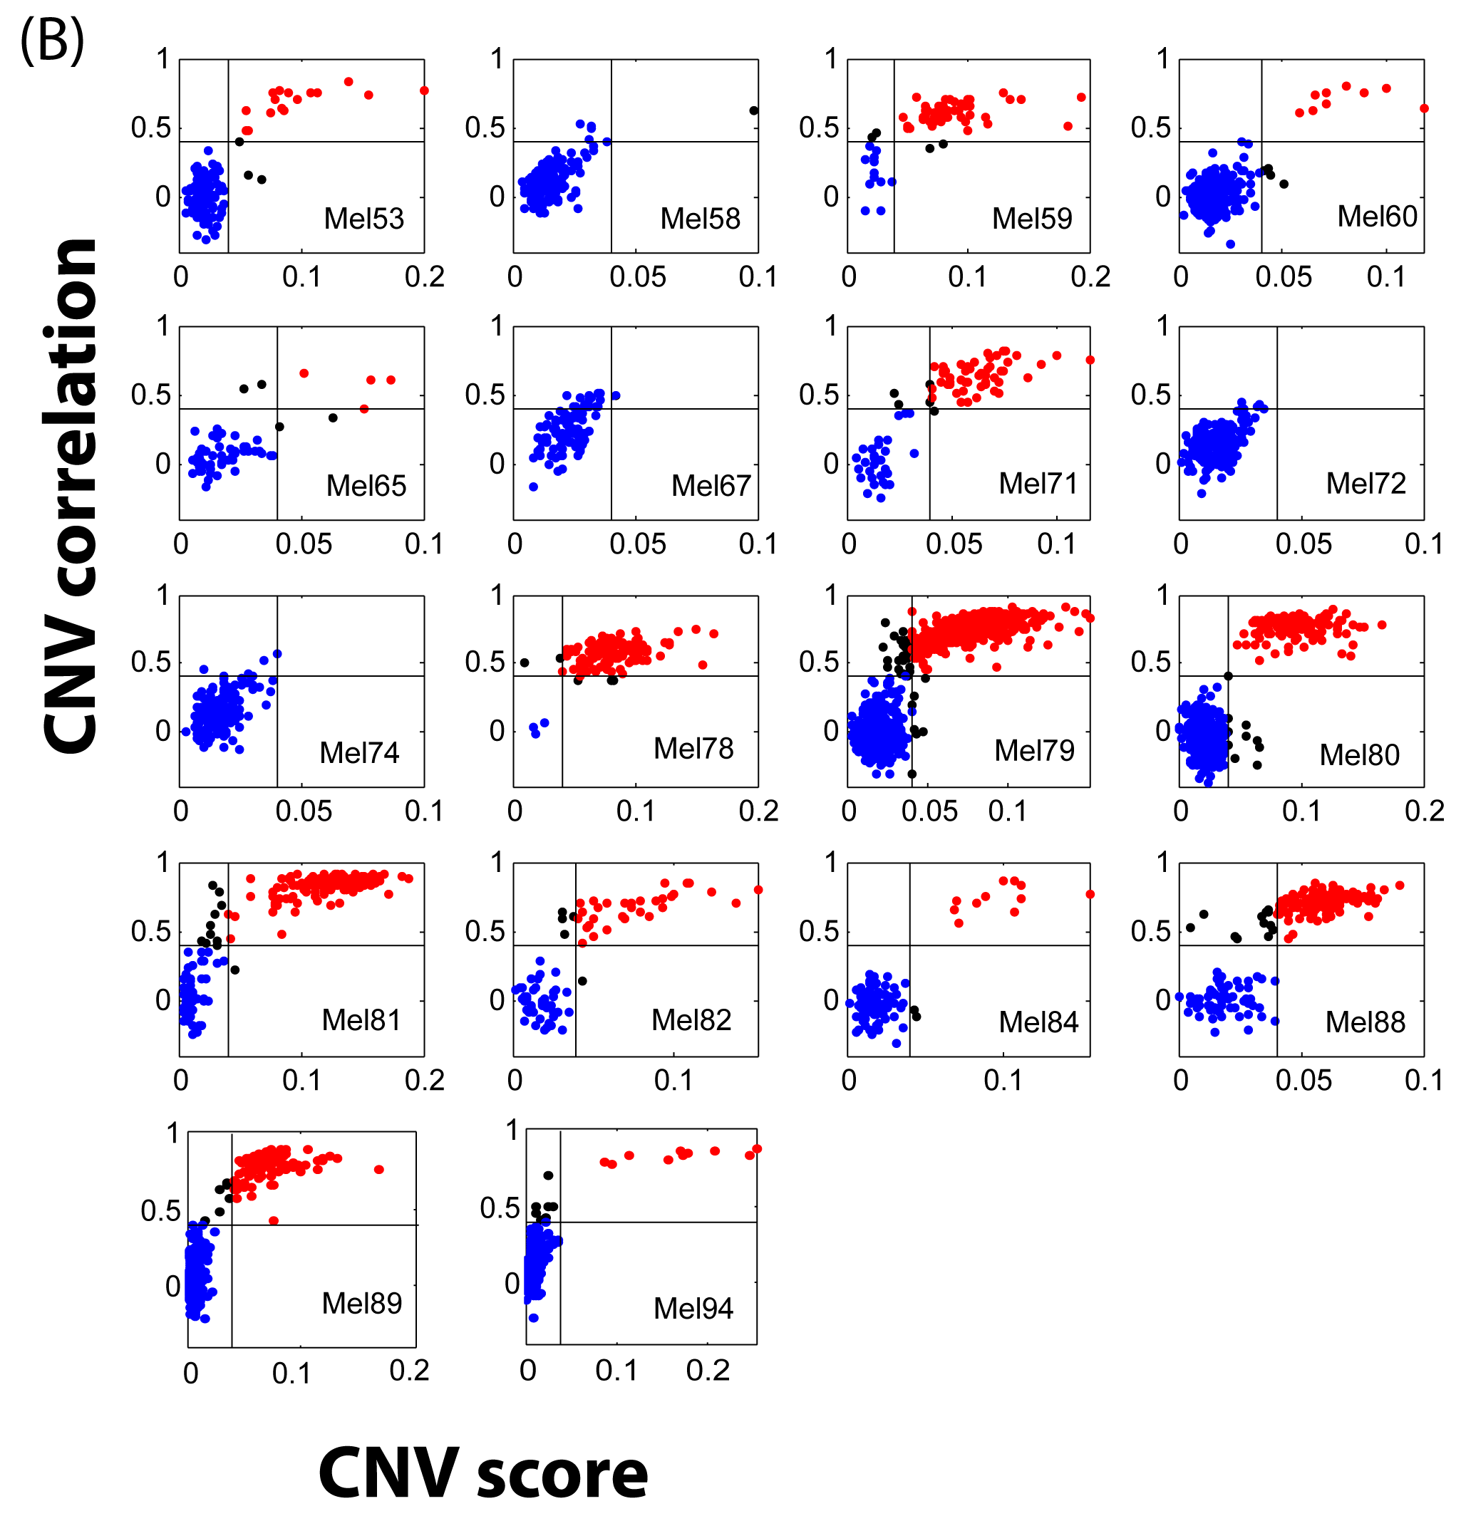
Figure 1: Dissection of melanoma with single-cell RNA-seq
Definitions
CNV: Variations of duplicates/copies of a particular gene from cell to cell.
Phenotype: observable characteristics of an individual by genotype and environment interaction
Transcriptional Programs: it identifies potentially represent common mechanisms of regulatory control across the genome
(B) Chromosomal landscape of inferred large-scale copy number variations (CNVs) distinguishes malignant from non-malignant cells. The Mel80 tumor is shown with individual cells (y-axis) and chromosomal regions (x-axis).
Amplifications (red) or deletions (blue) were inferred by averaging expression over 100-gene stretches on the respective chromosomes. Inferred CNVs are concordant with calls from whole-exome sequencing (WES, bottom).
Each plot compares two CNV parameters for all cells in Mel78 tumor:
Red dots infer malignant cells
CNV score > 0.04,
Correlation score < 0.4
Blue dots infer non-malignant cells
CNV score < 0.04
Correlation score < 0.4
Remaining are black
X-axis: overall CNV signal, the mean square of CNV estimates across all genomic locations
Y-axis: Pearson correlation coefficient b/w each cell’s CNV patten & average CNV pattern of the top 5% of cells in the same tumor w.r.t CNV signal.
(C,D) Single cell expression profiles distinguish malignant and non-malignant cell types. Shown are t-SNE plots of malignant (C, shown are the six tumors each with >50 malignant cells) and non-malignant (D) cells (as called from inferred CNVs as in B) from 11 tumors with >100 cells per tumor (color code). Clusters of non-malignant cells (called by DBScan, (17)) are marked by dashed ellipses and were annotated as T cells, B cells, macrophages, CAFs and endothelial cells, from preferentially expressed genes
Notes:
(B) indicates the patterns of abnormal number of chromosomes in a cell (in this case the cells of Mel80 tumor). This is part of the CNV analysis for cells within the tumor to designated cells as malignant and non-malignant. This is the first step to distinguishing cell types in melanoma.
(C) Using non-linear dimensionality reduction and density clustering (t-SNE) , malignant cells cluster together based on the tumors they were collected from.
(D) Non-malignant cells cluster based on cell types.
Grouping is done by selected marker genes (bold) and other genes that type a cell-type as shown in table below (not the complete table, only the top 8 rows)
T-cells | B-cells | Macrophages | Endothelial cells | CAFs | melanoma
'CD2' | 'CD19' | 'CD163' | 'PECAM1' | 'FAP' | 'MIA'
'CD3D' | 'CD79A' | 'CD14' | 'VWF' | THY1 | 'TYR'
'CD3E' | 'CD79B' | 'CSF1R' | 'CDH5' | DCN | 'SLC45A2'
'CD3G' | 'BLK' | 'C1QC' | 'CLDN5' | 'COL1A1' | 'CDH19'
'CD8A' | 'MS4A1' | 'VSIG4' | 'PLVAP' | 'COL1A2' | 'PMEL'
'SIRPG' | 'BANK1' | 'C1QA' | 'ECSCR' | 'COL6A1' | 'SLC24A5'
'TIGIT' | 'IGLL3P' | 'FCER1G' | 'SLCO2A1' | 'COL6A2' | 'MAGEA6'
'GZMK' | 'FCRL1' | 'F13A1' | 'CCL14' | COL6A3' | 'GJB1'
Supplementary Materials: S1

Slide 9
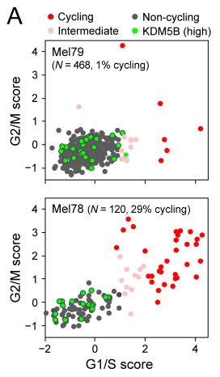
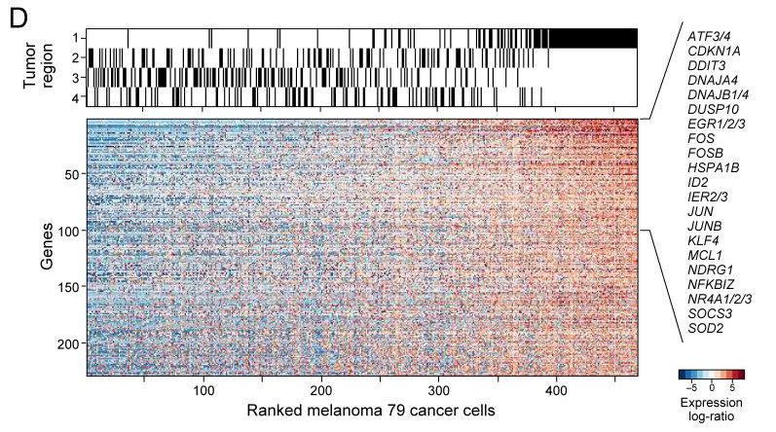
Figure 2: Single-cell RNA-seq distinguishes cell cycle and other states among malignant cells
Notes: Next step, analyses of malignant cells shows diversity in cell cycle and spatial organization using PCA (Tables):
PC1 is correlated to the number of genes detected/cell and “likely reflects technical aspects”
PC2-6 shows biological variability
PC2: Expression of cell-cycle genes.
Found cyclin D3 in high-cyclin tumors
KDM5B(transcriptional repressor) in non-cycling cells. KDM5B is associated with drug-resistant ,slow-cycling stem-like cells in mice.
PC3&6: genes that segregate different malignant cells
(D) 229 genes highly expressed in malignant cells of Region 1 compared to other areas of the rumor
The above point is similar to T cells; indicating “spatial effect that influences mulitiple cell types”
PC4&5: expression of MIFT (transcription factor gene for melanocytes transcription regulator)
Identifying and scoring cells based on the genes correlated with MIFT gene
Program negatively correlated to MIFT was also found (AXL) which is marker for therapy resistance.
Using both, we can distinguish between melanoma tumors e.g., MIFT-high or AXL- high tumors
(D) A gene expression program specific to Region 1 of Mel79, identified based on multifocal sampling. The relative expression of genes (rows) is shown for cells (columns) ordered by the average expression of the entire gene-set. The region-of-origin of each cell is indicated in the top panel (Fig. S5).
(A) Estimation of the cell cycle state of individual malignant cells (circles) on the basis of relative expression of G1/S (x-axis) and G2/M (y-axis) gene-sets in a low-cycling (Mel79, top) and a high-cycling (Mel78, bottom) tumor. Cells are colored by their inferred cell cycle states, with cycling cells (red), intermediate (light red) and non-cycling cells (black); cells with high expression of KDM5B (Z-score>2) are marked in cyan filling.
PC1 | PC2 | PC3 | PC4 | PC5
REACTOME_HOST_INTERACTIONS_OF_HIV_FACTORS (7.8126) | CELL_CYCLE_GO_0007049 (>16) | REACTOME_REGULATION_OF_COMPLEMENT_CASCADE (5.1407) | STRUCTURAL_CONSTITUENT_OF_RIBOSOME (5.0243) | PROTEIN_HETERODIMERIZATION_ACTIVITY (6.0762)
REACTOME_GLUCONEOGENESIS (6.8682) | REACTOME_CELL_CYCLE (>16) | REACTOME_INNATE_IMMUNE_SYSTEM (4.0295) | REACTOME_NONSENSE_MEDIATED_DECAY_ENHANCED_BY_THE_EXON_JUNCTION_COMPLEX (4.4431) | SPINDLE (4.4747)
KEGG_PARKINSONS_DISEASE (6.6129) | REACTOME_CELL_CYCLE_MITOTIC (>16) | KEGG_ANTIGEN_PROCESSING_AND_PRESENTATION (3.8092) | SYSTEM_DEVELOPMENT (4.3937) | KEGG_LYSOSOME (4.4148)
MITOCHONDRIAL_MEMBRANE (6.1728) | REACTOME_MITOTIC_M_M_G1_PHASES (>16) | GLUCAN_METABOLIC_PROCESS (3.8061) | REACTOME_SRP_DEPENDENT_COTRANSLATIONAL_PROTEIN_TARGETING_TO_MEMBRANE (4.3052) | MEMBRANE (4.4098)
REACTOME_HIV_INFECTION (6.1457) | REACTOME_DNA_REPLICATION (>16) | REACTOME_LIPID_DIGESTION_MOBILIZATION_AND_TRANSPORT (3.6338) | PIGMENT_BIOSYNTHETIC_PROCESS (4.2354) | KEGG_MELANOGENESIS (2.8868)
Genes
PC1 | PC2 | PC3 | PC4 | PC5
PPIA | PKMYT1 | PSAP | PLP1 | PLP1
EEF1A1 | CDK1 | SERPINA3 | CAPN3 | CANX
CFL1 | ASF1B | CSPG4 | CDH1 | ACSL3
MRPL12 | TK1 | LGALS3BP | ERBB3 | DDX5
ACTG1 | CDC45 | NEAT1 | S100B | TYR
PSMA2 | NUSAP1 | NUCB1 | RPLP1 | QPCT
PSMA6 | TOP2A | LAMB2 | PIR | MITF
ATP5G3 | BUB1 | HLA-A | STK32A | PSAP
ENO1 | AURKB | CTSD | TYR | CENPF
LDHA | CDC6 | PLXNB2 | MLANA | ETV5

Slide 10
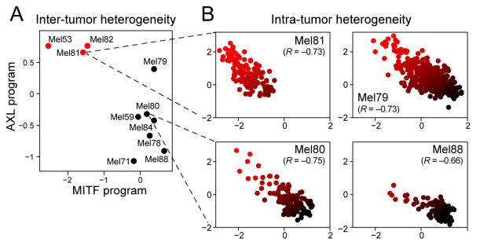
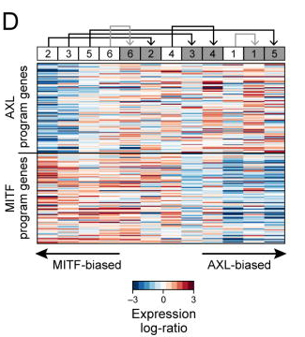
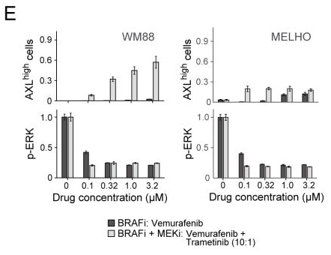
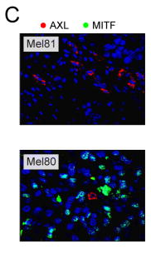
Figure 3: MITF- and AXL-associated expression programs vary between and within tumors, and following treatment
(A) Average expression signatures for the AXL program (y-axis) or the MITF program (x-axis) stratify tumors into ‘MITF-high’ (black) or ‘AXL-high’ (red). (B) Single-cell profiles show a negative correlation between the AXL program (y-axis) and MITF program (x-axis) across individual malignant cells within the same tumor; cells are colored by the relative expression of the MITF (black) and AXL (red) programs. Cells in both states are found in all examined tumors, including three tumors (Mel79, Mel80 and Mel81) without prior systemic treatment, indicating that dormant resistant (AXL-high) cells may be present in treatment naïve patients.
(D) Relative expression (centered) of the AXL-program (top) and MITF-program (bottom) genes in six matched pre-treatment (white boxes) and post-relapse (gray boxes) samples from patients who progressed through RAF/MEK inhibition therapy; numbers at the top indicate patient index. Samples are sorted by the average relative expression of the AXL vs. MITF gene-sets. In all cases, the relapsed samples had increased ratio of AXL/MITF expression compared to their pre-treatment counterpart. This consistent shift of all six patients is statistically significant (P<0.05, binomial test), as are the individual increases in AXL/MITF for four of the six sample pairs (P<0.05, t-test; black and gray arrows denote increases that are individually significant or non-significant, respectively).
(E) Quantitative, multiplexed single-cell immunofluorescence for AXL expression (y-axis top) and MAP-kinase pathway inhibition (pERK levels, y-axis) in the example cell lines WM88 and MELHO treated with increasing concentrations (x-axis) of either RAF inhibitor alone (dark gray bars) or a combination of RAF/MEK-inhibitors (light gray bars). We observed an increasing fraction of AXL-high cells (top panels) as well as a dose-dependent decrease of p-ERK (bottom panels) (Figs. S11–12 show additional cell lines).
(C) Mel81 and Mel80 immunofluorescence staining of MITF (green nuclei) and AXL (red), validating the mutual exclusivity among individual cells within the same tumor (Fig. S8).

Slide 11
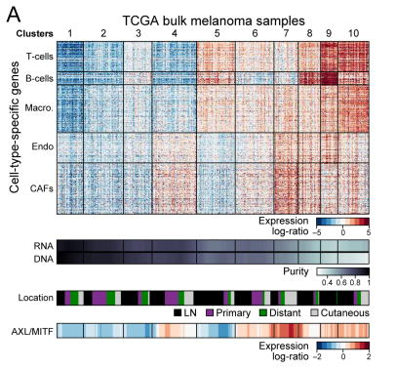
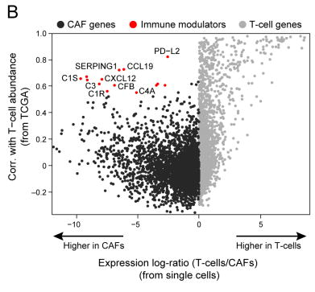
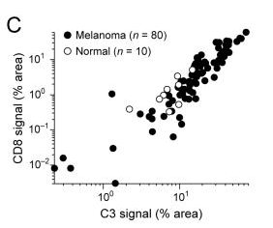
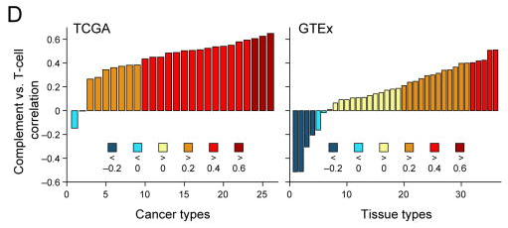
Figure 4. Deconvolution of bulk melanoma profiles reveals cell-cell interactions
(C) 90 samples with 80 tumor specimens (black dots) showing a correlation (R=0.86) between C3/CD8 signal by quantitative immunofluorescence and 10 normal control specimens (grey dots) (Fig. S18A–F shows normalization and additional specimens).
(B) Inferred cell-to-cell interactions between CAFs and T cells. Scatter plot compares for each gene (circle) the correlation of its expression with inferred T cell abundance across bulk tumors (y-axis, from TCGA transcriptomes) to how specific its expression is to CAFs vs. T cells (x-axis, based on single-cell transcriptomes). Genes that are highly specific to CAFs in a single cell analysis of tumors (red), but also associated with high T cell abundance in bulk tumors (black border) are candidates for CAF/T cell interactions.
(A) Bulk tumors segregate to distinct clusters on the basis of their inferred cell type composition. Top panel: heat map showing the relative expression of gene sets defined from single-cell RNA-seq as specific to each of five cell types from the tumor microenvironment (y-axis) across 471 melanoma TCGA bulk-RNA signatures (x-axis). Each column is one tumor and tumors are partitioned into 10 distinct patterns identified by K-means clustering (vertical lines and cluster numbers at the top). Lower panels show, from top to bottom, tumor purity estimated by ABSOLUTE (DNA) and RNA-seq analysis (RNA), specimen location (from TCGA), and AXL/MITF scores. Tumors with high abundance of CAFs are correlated with an increased ratio of AXL-program/MITF-program expression (bottom).
(D) Correlation coefficient (y-axis) between the average expression of CAF-derived complement factors shown in (B) and that of T cell markers (CD3/D/E/G, CD8A/B) across 26 TCGA cancer types with >100 samples (x-axis, left panel) and across 36 GTEx tissue types with >100 samples (x axis, right panel). Bars are colored on the basis of correlation ranges as indicated at the bottom.

Slide 12
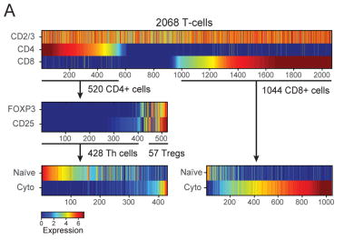
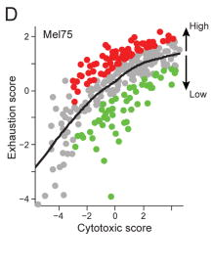
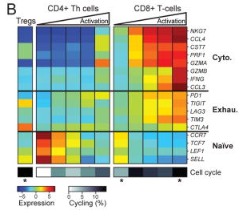
(A) Figure 5. Activation-dependent and independent variation in T-cell exhaustion markers
(A) Single T cell stratification into CD4+ and CD8+ cells (upper panel), CD25+FOXP3+ and other CD4 cells (middle panel) and their inferred activation state (lower panel, from average expression of the cytotoxic and naïve gene-sets in (B)).
(B) Average expression of markers of cytotoxicity, exhaustion and naïve cell states (rows) in (left to right) Tregs, CD4+ T cells, and CD8+ T cells; CD4+ and CD8+ T cells are each further divided into five bins by their cytotoxic score (ratio of cytotoxic to naïve marker expression levels), showing an activation-dependent co-expression of exhaustion markers. Bottom: proportion of cycling cells (calculated as in Fig. 2B). Asterisks denote significant enrichment or depletion of cycling cells in a specific subset compared to the corresponding set of CD4+ or CD8+ T cells (P<0.05, hypergeometric test).
(D) Activation-independent variation in exhaustion states within highly cytotoxic T cells. Scatter plot shows the cytotoxic score (x-axis) and exhaustion score (y-axis, average expression of the Mel75 exhaustion program as in Fig. S21) of each CD8+ T cell from Mel75. In addition to the overall correlation between cytotoxicity and exhaustion, the cytotoxic cells can be sub-divided into highly exhausted (red) and lowly exhausted cells (green) based on comparison to a LOWESS regression (black line). (E–F) Relative expression (log2 fold-change) in high vs. low exhaustion cytotoxic CD8+ T cells from five tumors (x-axis), including 28 genes that were significantly upregulated (P<0.05, permutation test) in high-exhaustion cells across most tumors

Slide 13
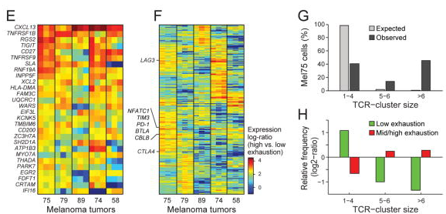
(B) Figure 5. Activation-dependent and independent variation in T-cell exhaustion markers
(G) Expanded TCR clones. Cells were assigned to clusters of TCR segment usage (black bars; Fig. S23), and cluster size (x-axis) was evaluated for significance by control analysis in which TCR segments were shuffled across cells (grey bars). The percentage of Mel75 cells (y-axis) is shown for clusters of small size (1–4 cells) that likely represent non-expanded cells, medium size (5–6 cells) that may reflect expanded clones (FDR=0.12), and large size that most likely reflect expanded clones (FDR=0.005).
(H) Expanded clones are depleted of non-exhausted cells and enriched for exhausted cells. Mel75 cells were divided by exhaustion score into low exhaustion (green, bottom 25% of cells) and medium-to-high exhaustion (red, top 75%). Shown is the relative frequency of these exhaustion subsets (y-axis) in each TCR-cluster group (x-axis, as defined in G), defined as log2-ratio of the frequency in that group compared to the frequency across all Mel75 cells. All values were significant (P<10⁻⁵, binomial test).
(F). Three independently derived exhaustion gene-sets were used to define high and low exhaustion cells (Mel75, (17, 46, 48)), and the corresponding results are represented as distinct columns for each tumor.
(E) and 272 genes that were variably associated with high-exhaustion cells across tumors

