Slide 1




NCBI Webinar:
Submitting BioSamples to NCBI
Closed captioning: www.captionedtext.com and enter 2914235
The recording, will be on our YouTube channel in the Webinars playlist:
<youtube>/user/NCBINLM/playlists
Use the questions pod to ask questions as you think of them. We will pause during the webinar to answer questions or we may need to wait until the end of the webinar.
We will keep all questions and provide answers after the webinar via a link to our Webinars page:
    <ncbi>/home/coursesandwebinars.shtml
Materials: http://1.usa.gov/1RBERXx

Slide 2
Submitting BioSamples to NCBI
https://submit.ncbi.nlm.nih.gov/subs/biosample/

Slide 3
Webinar Logistics - 1
Introductions
  Bonnie Maidak, Introducer
  John Anderson, Presenter

Slide 4
Webinar Logistics - 2
Slides available now at:
ftp://ftp.ncbi.nlm.nih.gov/pub/education/public_webinars/2016/04Apr13_BioSample/
or
http://1.usa.gov/1RBERXx
Access closed captioning at:
  http://www.captionedtext.com and enter 2914235
All content, including a video recording, will be available via a link to our Webinars page at: <ncbi>/home/coursesandwebinars.shtml
  For functional links, replace <ncbi> with www.ncbi.nlm.nih.gov/ in the above link and other abbreviated links provided in the webinar

Slide 5
Submitting BioSamples to NCBI
https://submit.ncbi.nlm.nih.gov/subs/biosample/
Notes:
In the last few years, new technologies have made it easier and easier to produce large amounts of sequence data from biological materials.
One of the major challenges for NCBI has been to find a way to organize this data to make it accessible and useful to researchers.
As part of that effort, we have created a database to collect and store the information about the biological specimens used to create this data.
It is called the BioSamples database and it is the central repository for biological source information for the many primary sequence archives at NCBI.

Slide 6
Outline
Introduction –
  What is a biosample?
  When is it required?
  What should it include?
  Packages (Sample Type)
Submission of a single record – demo
  Release date
  Attributes
Batch submission
  Templates
The introduction will use much of the same information found in the FAQ located at:
http://www.ncbi.nlm.nih.gov/biosample/docs/submission/faq/
Notes:
Today I’d like to introduce you to the biosamples database and explain some of the concepts
And then take you through a demonstration of a couple of actual submissions

Slide 7
What is a BioSample?
Let’s begin by considering a very simple hypothetical example.
Imagine I have a grant to study the effects of arsenopyrite (AsFeS) as an environmental contaminant.
We know that AsFeS affects metabolic pathways in bacteria, so I want to characterize the effect of different concentrations on the expression of specific genes in a particular species of bacteria.

Slide 8
What Do I Know
Organization of my study:
Transcriptome project to study expression under specific arsenic conditions
Method - RNA sequencing
Samples
  AsFeS treatments
  Other information
Notes:
In my mind, I understand the organization of my study and I can describe all its components. I know what the project is about, I know what my experiments were, and I have the sequence results.
The project is a Transcriptome project to study expression under specific AsFeS conditions, and my method is RNA sequencing.
I have a list of samples, with the information about the AsFeS treatments, since that’s central to the project, and I have recorded other information that might be relevant or useful as well.

Slide 9
When try to I submit my sequences to NCBI, they tell me I need to submit a “BioProject” for the project and “BioSamples” with the “sample metadata” for the source material.
What are those?

Slide 10
BioProject, BioSample
and data objects
In NCBI terms, the project description is called a BioProject.
The sequences you are submitting are the data.
The BioSample is a record of each sample and the information about the sample itself.
Notes:
The BioProject is a record that provides a container for a formalized version of the project description.
It has it’s own ruleshas its own database. Submission of a bioproject is fairly simple, but we won’t go into that today.
Data mean sequence data and these have their own archives and submission procedures.
The BioSample is the record that stores the information about the samples.

Slide 11
Organization of BioProject, BioSample
and data objects
BioProject
BioSample
BioSample
BioSample
BioSample
BioSample
Data
Data
Data
Data
Data
Notes:
This slide illustrates how NCBI organizes the records for this information.
Under the BioProject, you have the BioSamples and the data derived from them.

Slide 12
What is a BioSample?
Sample - the physical biological specimen from which your experimental data are derived.
BioSample - the record that stores the information about the sample
We refer to the information as “metadata”, since it is a set of data that describes your data.
Notes:
The sample is the actual biological material that the data came from.
The biosample is a data file that contains the metadata for your sample.
Sample metadata is analogous to metadata for a digital photo file.
When you take a picture with your digital camera, it records the image (that’s the data) but it also records other information, like date the picture was take and the various camera settings. That is called the metadata
Similarly, when you generate data, there is information about the sample that is useful or even critical to have.

Slide 13
Why is a BioSample a separate record?
A single biological specimen can be used to generate different kinds of data.
Genomic sequence
RNA Transcripts
Expression data
The BioSamples database serves as the master record for the sample information.
Notes:
Why not store the sample information directly in the data file, like you do with a digital photo? [we used to do this with genbank]
The problem is that a sample can be used to generate different kinds of data and those data files go to many different databases.
If we record the sample metadata on each of those data files, it becomes very hard to maintain.
- Different databases may collect different information that is hard to reconcile.
- Any Updates to the information would have to be done to every instance of the record.
Having a master sample record that all data records point to simplifies all of this.

Slide 14
When is it required to submit to the BioSample database?
BioSample submission is currently required as part of data deposit to several NCBI primary data archives:
SRA - Sequence Read Archive
TSA - Transcriptome Shotgun Assembly Sequence Database
WGS - Whole Genome Shotgun
Notes:
NCBI requires a biosample record for sequence data submitted to our major sequ3ence archives,
SRA (Sequence Read Archive),
TSA (Transcriptome Shotgun Assembly Sequence Database) and
WGS (Whole Genome Shotgun).
GenBank and GEO also use biosample, but have a separate method to collect the information.

Slide 15
Example BioSample record
Notes:
Here we see a typical BioSample record.
A title that is descriptive of the sample
Accession number is the permanent stable identifier for the record. Ones submitted to NCBI always start with SAMN. EBI and DDBJ use SAME and SAMD.
- the sample name is chosen by the submitter and is required to be unique
Organism – scientific name from the NCBI Tax database
Sample Type (Package) = we’ll talk about this later
Related Information has BP again, SRA, Tax links
Submission shows submitter and date of submission.
Attributes
- There are predefined attributes. This lets us standardize the information we get and makes it possible to aggregate samples with similar characteristics
- the attributes are designed to be flexible, so custom names are accepted. Custom names allow you to enter any attribute you need to comprehensively describe your samples.”

Slide 16
When do I need an individual BioSample?
A BioSample should hold the information for specimens that are distinct in some biologically meaningful way.
  Different individuals
  Different tissues
  Different time points
  Different treatments
  Anything else that is relevant to your study
Notes:
The previous slide showed what a record looks like, but what do we consider a “SAMPLE”?
I’ll illustrate these examples on the next few slides

Slide 17

Different individuals
sample_name | organism | tissue | geo_loc_name
mouse_1 | Mus musculus | tail clip | France: St. Lo
mouse_2 | Mus musculus | tail clip | Philippines: Mindanao
mouse_3 | Mus musculus | tail clip | New Guinea: Mount Hagen
mouse_4 | Mus musculus | tail clip | Taiwan: Xinyi Township
Notes:
Different individuals are obviously different samples
Here we see an example set of samples that are all the same species of mice, but collected at different locations.
Clearly, each of these would need a separate biosample record.

Slide 18

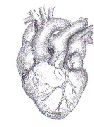
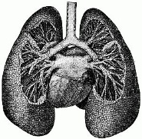
Different tissues from the same individual
sample_name | organism | tissue | isolation_source
patientX_lung | Homo sapiens | lung | patient_X
patientX_heart | Homo sapiens | heart | patient_X
Notes:
Different tissues from the same individual are different samples.
For a genomic study, the tissue might not matter,
But for a transcriptome or epigenetic study, identifying differences between the tissues might be the whole point of the study.
If the difference is relevant for your study, you need to record it.

Slide 19



Different time points for the same individual
sample_name | organism | tissue | age | collection_date
mouse_AB134_time_1 | Mus musculus | muscle biopsy | 1 month | 25-Sep-2011
mouse_AB134_time_2 | Mus musculus | muscle biopsy | 2 months | 25-Oct-2011
mouse_AB134_time_3 | Mus musculus | muscle biopsy | 3 months | 26-Nov-2011
mouse_AB134_time_4 | Mus musculus | muscle biopsy | 4 months | 24-Dec-2011
Notes:
For a single individual sampled at different time point, each time point can be considered a different sample.
Here we have a single mouse samples at 4 different ages.
Since these are distinct in ways that are relevant to the study, the information should be recorded as separate biosamples.

Slide 20
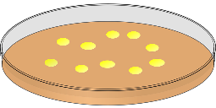
Different treatments of the same organism
sample_name | organism | growth temp | AsFeS concentration
low_culture | Escherichia coli | 37 C | 0.1 mM
high_culture | Escherichia coli | 37 C | 1.0 mM
Notes:
The same organism treated with different conditions would be different samples.
Two cultures of the same bacterial strain, but grown under different conditions would need separate biosample records.

Slide 21
Multiple cultures of the same strain do not need separate BioSamples
sample_name | organism | growth temp | AsFeS concentration
low_culture | Escherichia coli | 37 C | 0.1 mM
Notes:
On the other hand, multiple plates of the same clone, not handled in any way that would affect your study would NOT be considered to be different samples.
That is, you do not need to submit a new BioSample record every time you use this strain for an experiment.

Slide 22
Multiple data types from the same sample do not need separate BioSamples
RNA
transcriptome
genome
DNA
sample_name | organism | tissue | isolation_source
patientX_lung | Homo sapiens | lung | patient_X
Notes:
A sample used to generate different data types is still just a single sample.
If you used the same sample to generate a transcriptome and genomic sequences, there is no reason to register two biosample records.
The data files can both point to the same BioSample record as the source material.

Slide 23
Technical replicates do not need separate BioSamples
Sequencing run 1
Sequencing run 2
Sequencing run 3
Sequencing run 4
sample_name | organism | isolation source | Lab_ID_number
mouse_1 | Mus musculus | muscle biopsy | AB134
Notes:
A sample used to generate repeats of the same data is still just a single sample.
Next Generation Sequencing platform delivers hundreds of files for a single sample, but you don’t need a separate BioSample record for each.
Similarly, if you repeat the sequencing or do it again on a different platform, those may be different EXPERIMENTS, but there is still only one biosample record needed.

Slide 24
Metagenomes
Environmental or clinical samples that are expected to contain multiple organisms.
Usually microbial (including archaea, bacteria and fungi but not restricted to those)
Metagenome can be thought of as a Microbiome
Notes:
So far, we’ve talked about organismal samples.
There is a special class of biological sample that is an environmental or clinical sample where you expect to find multiple organisms.
We refer to these as metagenomes
The terminology is partially historical, since the first instances of this sample type were for genomic sequencing, but it now includes any sample of this type, regardless of the type of data that will be generated.
Even though the sample may contain thousands of organisms of many species, it is still a single physical sample
The information in the BioSample record refers to that sample, not the individual organisms.
Metagenomes are defined by location, substance sampled, time of sampling, etc.

Slide 25
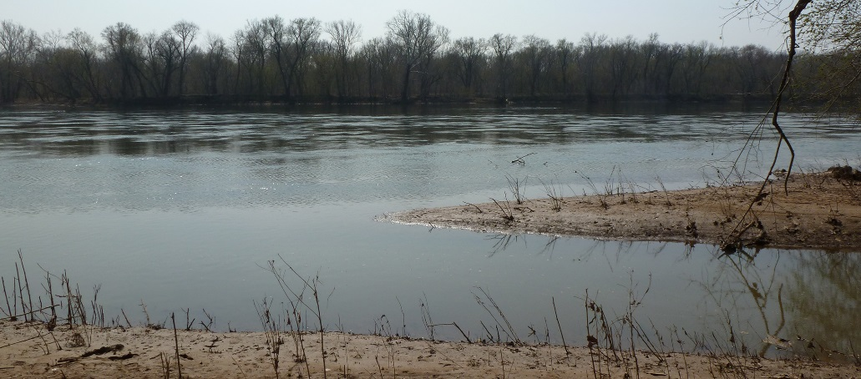
Example Metagenome
Water samples from different locations
in the same river would require separate biosample records.
sample_name | organism | depth | geo_loc_name | lat_lon | collection_date
Potomac_creek_mouth | freshwater metagenome | 0.5 M | USA: MD, creek mouth | 39.04518 N 77.293539 W | 25-May-2014
Potomac_deep_channel | freshwater metagenome | 2.0 M | USA: MD, Blockhouse Point | 39.053885 N 77.294912 W | 25-May-2014
Muddy_Branch | freshwater metagenome | 0.5 M | USA: MD, Muddy Branch | 39.05875 N 77.294539 W | 25-May-2014
Potomac_shoreline | freshwater metagenome | 0.1 M | USA: MD, Blockhouse Point | 39.055151 N 77.29444 W | 25-May-2014
Notes:
Here we have a hypothetical set of samples that are water taken from different places in the same river. The goal might be to look for differences in bacterial species composition in the different locations.
These were all collected on the same date
The exact location is the main difference.
arrows on the slide show the locations
geo_loc_names describe this
lat_lon coordinates give the precise locations
The depth is additional information that might be important in interpreting the results.

Slide 26
Metagenome results are not separate BioSamples
Short sequences from multiple organisms are produced.
Organisms are identified by sequence homology to know organisms.
You do not need a separate biosample for each identified sequence.
The sequence files all refer to the same BioSample record as the source material.
Organisms identified in SRA Runs
sample_name | organism | depth | geo_loc_name | lat_lon | collection_date
Potomac_creek_mouth | freshwater metagenome | 0.5 M | USA: Maryland, creek mouth | 39.04518 N 77.293539 W | 25-May-2014
Notes:
A single metagenome sample can produce hundreds of separate sequence files and identify many species, but it’s just one sample
Usually, the sequences generated from a metagenome study are short reads and submitted to SRA.
Organisms are identified by sequence homology to know sequences. Often, identifying the organisms present in the sample is the goal of the study.
In these cases, you do not need a separate biosample for each identified organism. That information goes with the sequence record.
The sequence files derived from a single physical environmental sample would all refer to the same BioSample record as the source material.

Slide 27
Exception: when you do need a separate BioSample for metagenome results
Short reads for a single organism can be assembled into a complete genome
NCBI Genomes submission rules require
  that you identify the species and
  create a BioSample record for the uncultured organism.
A note is made on the record that it was derived from the original metagenome sample.
Notes:
Exception is that WGS wants a separate organismal biosample
If you align enough short reads from a single taxon in your metagenome sample, you may be able to assemble a complete genome for that organism.
If you submit that assembly to NCBI, rules for NCBI Genomes submission require that you identify the species and register a separate BioSample record for the uncultured organism.
A note is made on the record that it was derived from the original metagenome sample.

Slide 28
Sample Types (Packages) are our next topic
Metagenomes are one example of a Sample Type (Package)
Notes:
In an effort to improve the quality of the information we collect for BioSamples, we have organized them into categories based on what type of data we need to collect for each type of sample.

Slide 29
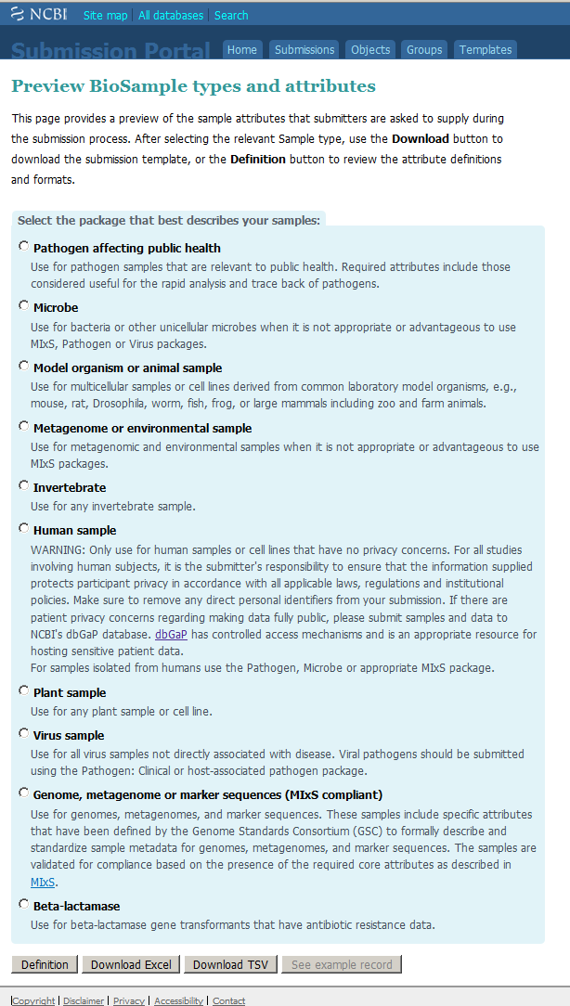
Sample Type
(Package)
The packages are designed:
to improve the quality of the information gathered
to be organism specific
to gather information appropriate for the organism
http://www.ncbi.nlm.nih.gov/biosample/docs/submission/validation/
Notes:
The goal is to improve the quality of the information gathered.
ANIMATION: Shows the different package types
Mostly based on organism type
These are designed to make it possible to ask for attributes that are more appropriate for that sample.
When you are submitting to BioSamples, you should read the descriptions and choose the package that is most appropriate for your organism.
Examples of this follow, a couple of slides later.

Slide 30
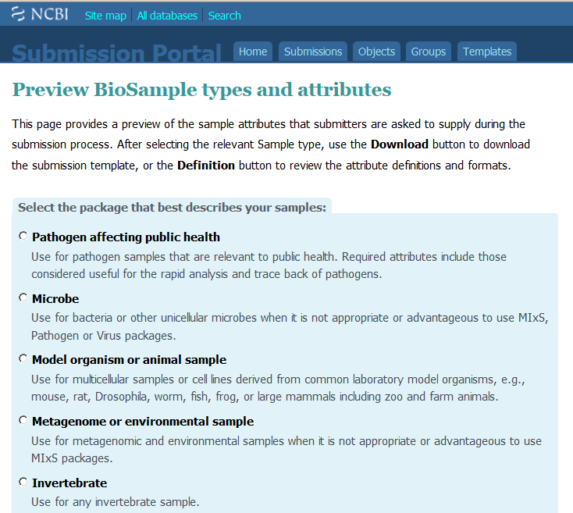
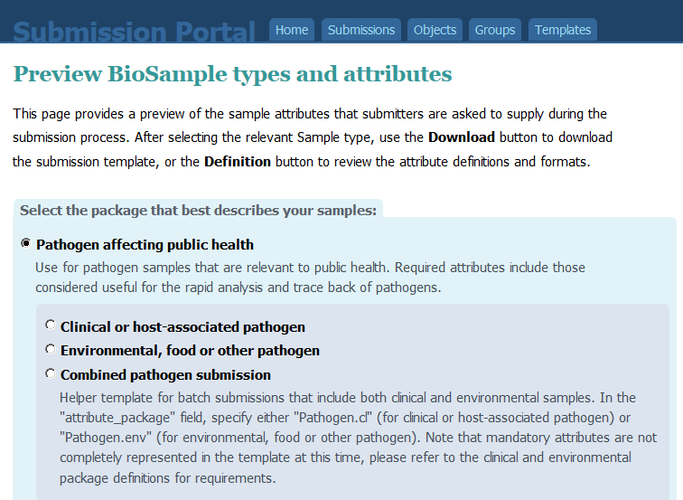
Some Packages have sub-categories
Notes:
ANIMATION: Pathogen is divided into two types that ask for slightly different information.

Slide 31
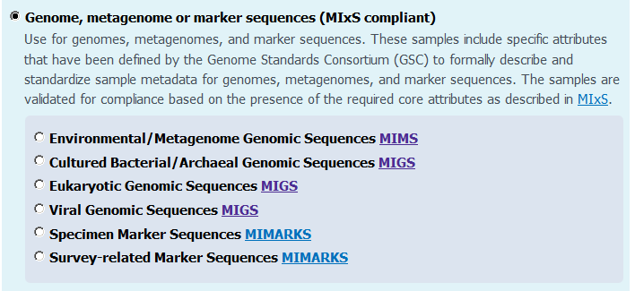
Some Packages have sub-categories
Notes:
The Genome Sequence Consortium has a set of sample types that are similar to NCBI’s packages
ANIMATION: These overlap with NCBI’s standards and have stricter requirements in most cases.
If you want to follow the GSC standards, you should choose one of these packages

Slide 32
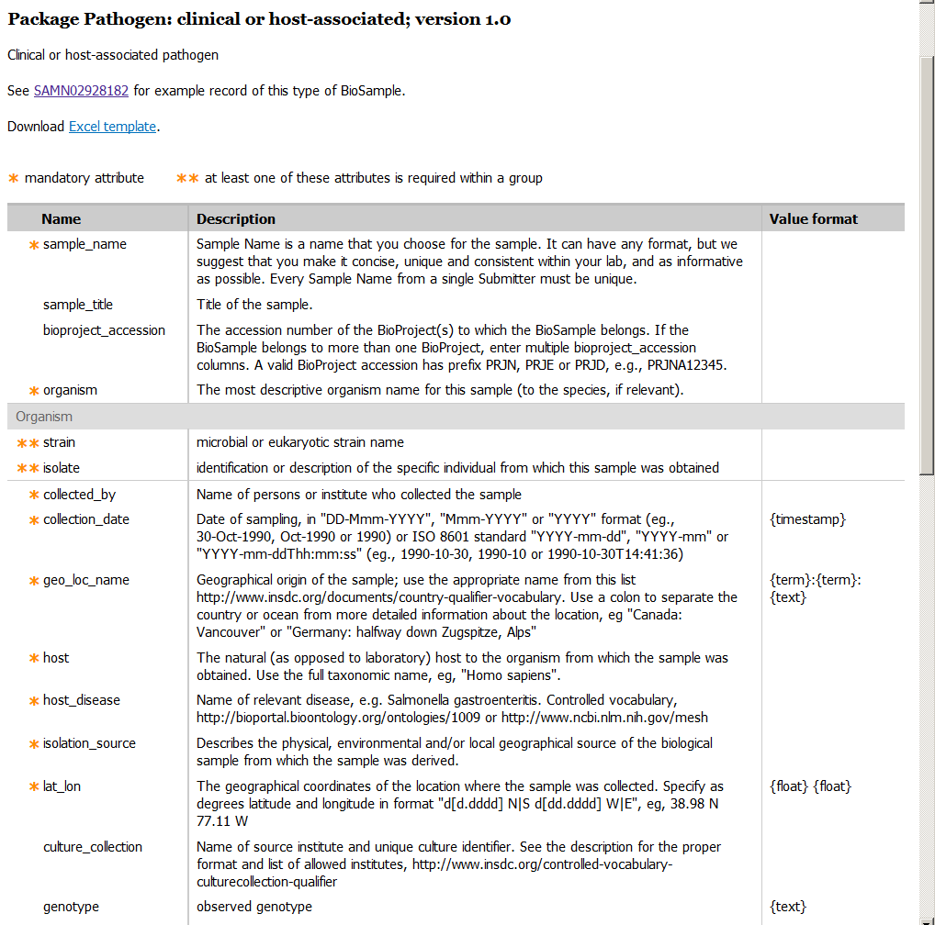
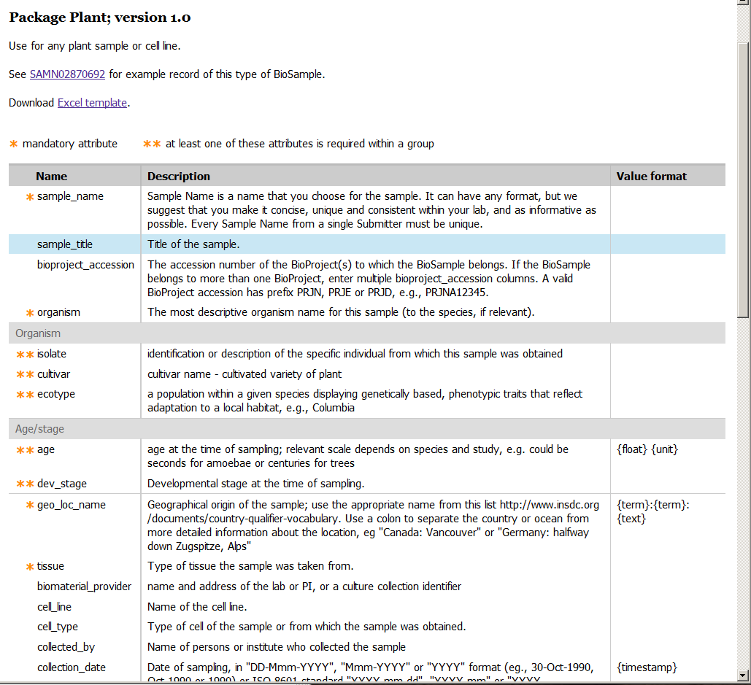
Attributes for a Sample Type
Each Sample Type (Package) has a set of required attributes tailored to that organism or sample type
Notes:
You can get a set of definitions for each of the packages by choosing one and then clicking on the Definition button on the templates web page.

Slide 33
Example Package - Pathogen
Pathogen, clinical or host-associated
Notes:
Explain the notation
Means a required attribute
** means that you must provide one of the multiple choices
This example is for Pathogen - clinical
- "strain" or "isolate" are appropriate terms for bacteria and most other microorganism
"host" is typical for clinical samples, since the disease is usually in an organism, like human or a pet, etc.
For an environmental sample, you’d use isolation)source instead
Below this, there is a long list of Pre-defined attributes, which I mentioned earlier.
In order to allow for terms we haven’t thought of that nevertheless might be important for a research to include in his data, we allow custom attributes as well. I’ll show you how to create those later.

Slide 34
Example Package - Plant
Plant
Notes:
Explain the notation *, **,
Example 2: Plant
- "cultivar" and "ecotype" are terms specifically used in botany. "isolate" adds flexibility.
- 'age' and 'dev_stage" may be appropriate, depending on the life cycle of your plant

Slide 35
Questions?

Slide 36
Outline
Introduction –
  What is a biosample?
  When is it required?
  What should it include?
  Packages (Sample Type)
Submission of a single record – https://submit.ncbi.nlm.nih.gov/
  Release date
  Attributes
Batch submission
  Templates
Notes:
Now we’ll switch to a live demonstration of submitting a biosample to NCBI.
This link takes us to the submission portal landing page
You will need to have already created a user account and logged on.

Slide 37
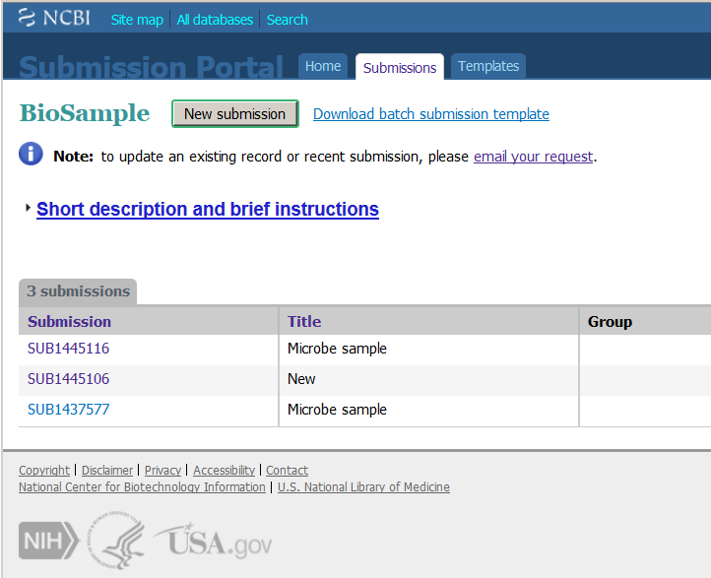
Notes:
This page Shows your previous biosample submissions
Click New Submission to start a new submission

Slide 38
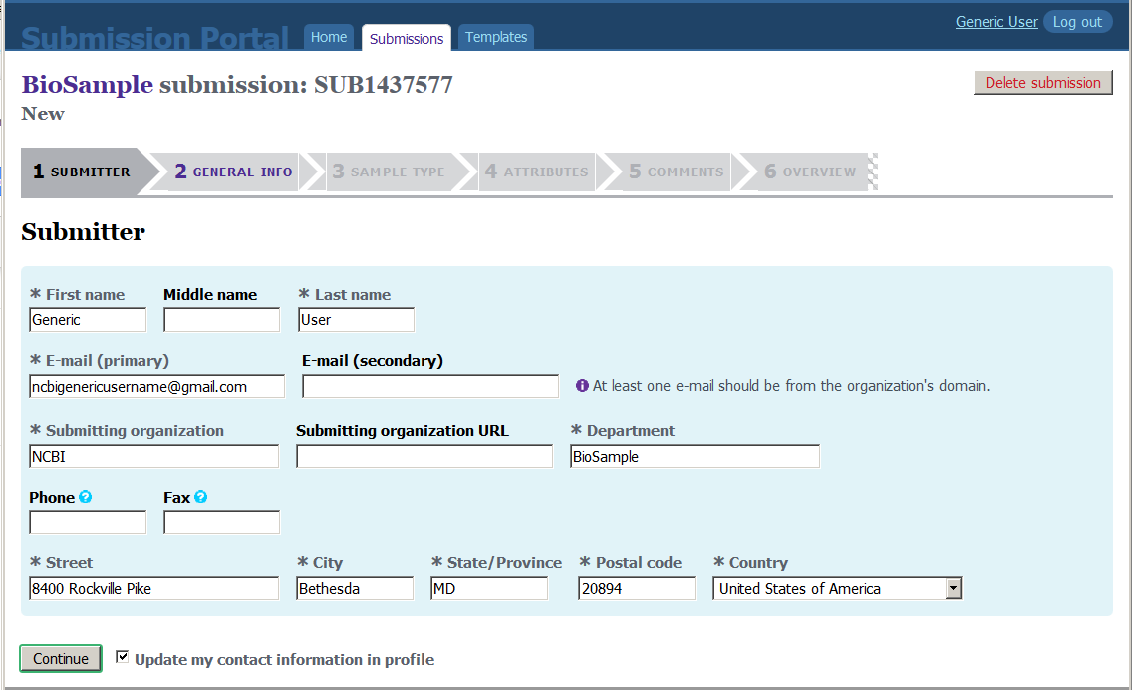
Notes:
A new submission is created
The submission ID SUBxxxxx is a temporary ID and only applyies to the submission session itself. You should not use it in a publication. You can use it to communicate with us about your submissions.
The Submission Wizard software takes you through a series of tabs to collect your information. These need to be completed in order before proceeding to the next.
Submitter is autofilled from your user profile
Click continue to accept the information and move on

Slide 39
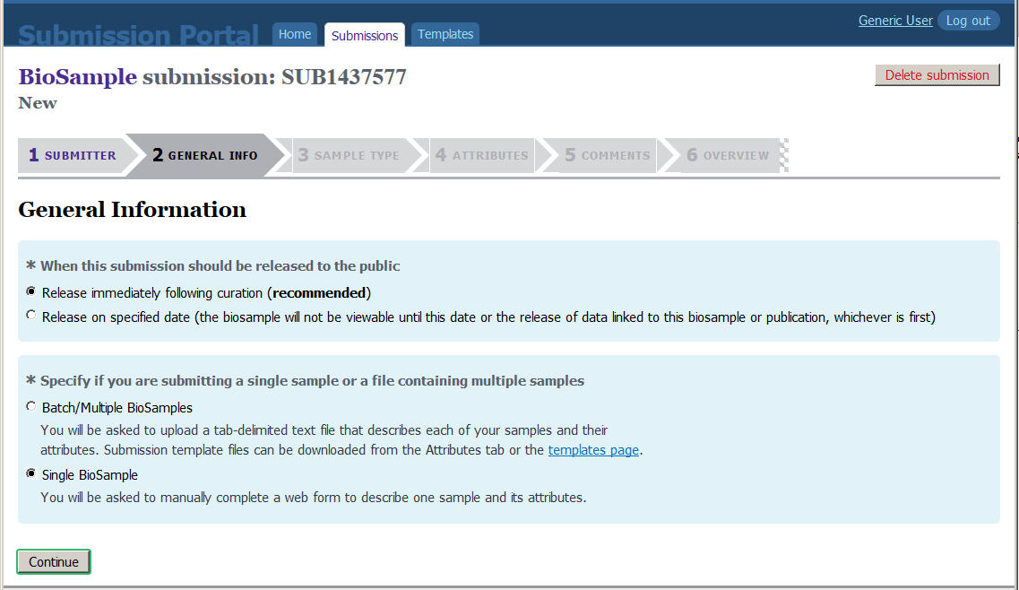
Notes:
Explain release date
immediately made public after processing
if you are not ready for your data to be public, you can specify a release date in the future. The record will be held private until either the specified date is reached or the accession number is published or linked data are made public.
Single vs batch
We’re doing single now.

Slide 40
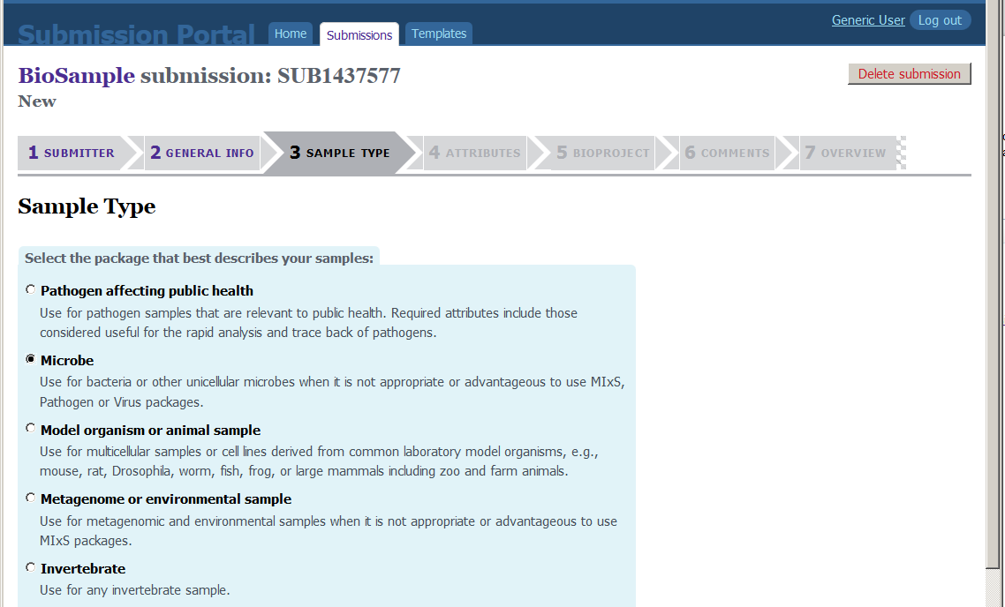
Notes:
Choose sample type
Use animal in this example

Slide 41
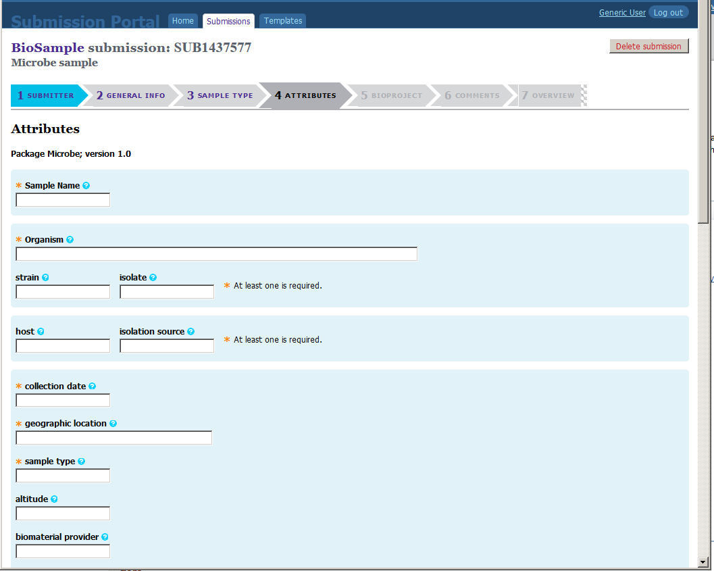
Notes:
Explain form fields.
required fields indicated with *
definitions under “?”
Scroll down and up to show predefined attrubutes
Show custom attribute

Slide 42
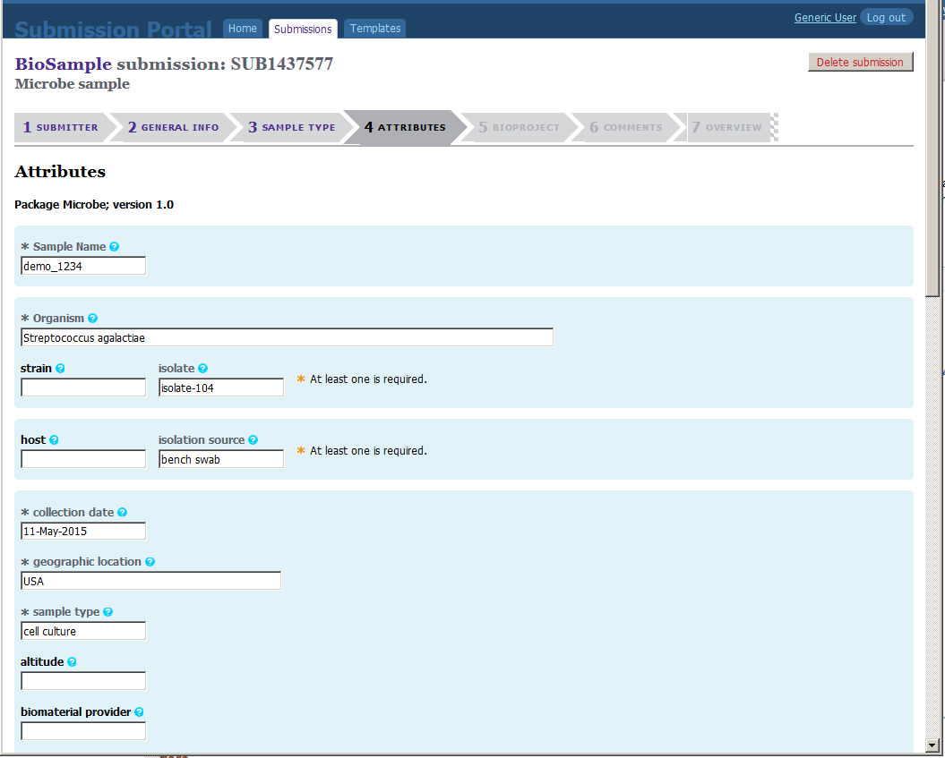
Notes:
Sample name = Coyote1
Type “Canis l” to show autofill
Breed = wildtype
Age = 2 years - units are not required or validated at this time
Show sex pulldown
Can use “missing” for tissue to show that that’s OK.
Lat_lon= 34.4 N 115 W – note map shows location
Enter custom - ear tag = none
Requirements are filled in – hit continue. Validation occurs in real time, so you get immediate feedback on errors.

Slide 43
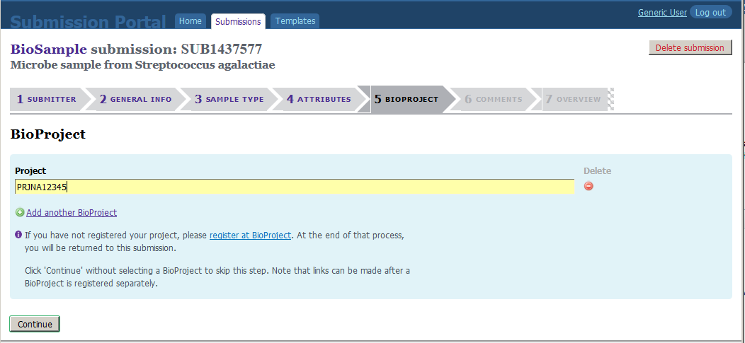
Notes:
If you have already submitted a bioproject, you can enter the accession number here
Must be PRJNA
Not required. Links can be created later through data.

Slide 44
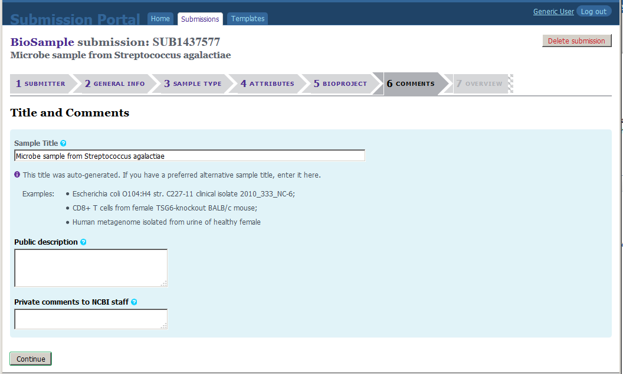
Notes:
The title will be autogenerated.
But you can add a custom title for the sample.

Slide 45
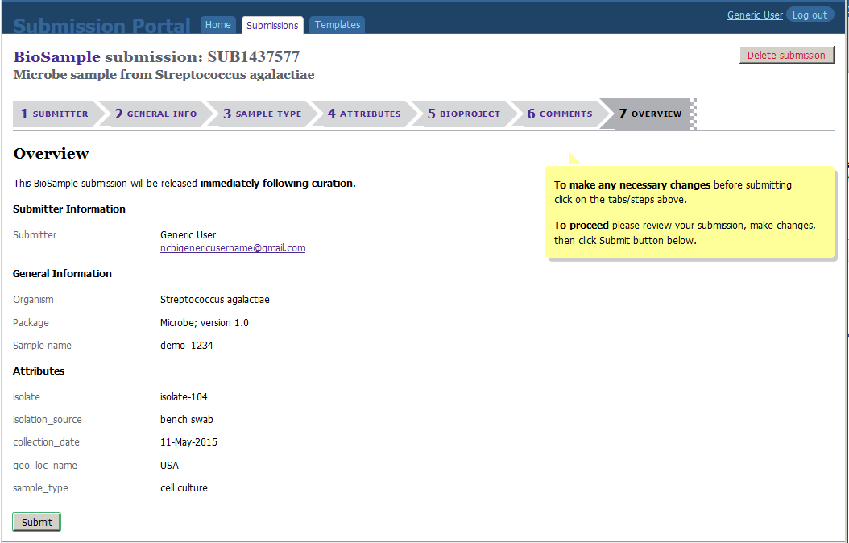
Notes:
Summary page:
Review information. You can go back to any of the tabs at this point to make changes if you need to.
When you are satisfied, click submit.
Record leaves SP and goes into BioSample database.
If organism name is in taxonomy, the record will be autoprocessed and released in minutes.
If there are any errors, including taxonomy, human curators will review the record and then release it. This can take from a few hours to a few days.

Slide 46
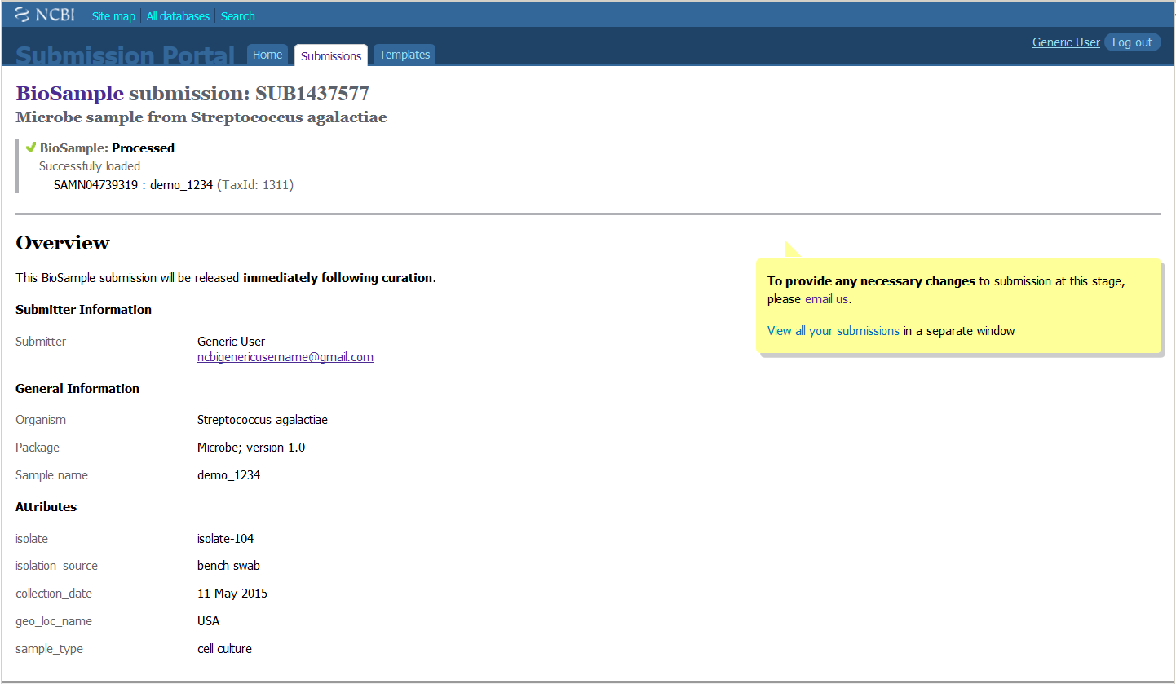
Notes:
This is after processing.
Note that it now has a BioSample accession number. This is what you use in publications and when communicating with us about the record.

Slide 47
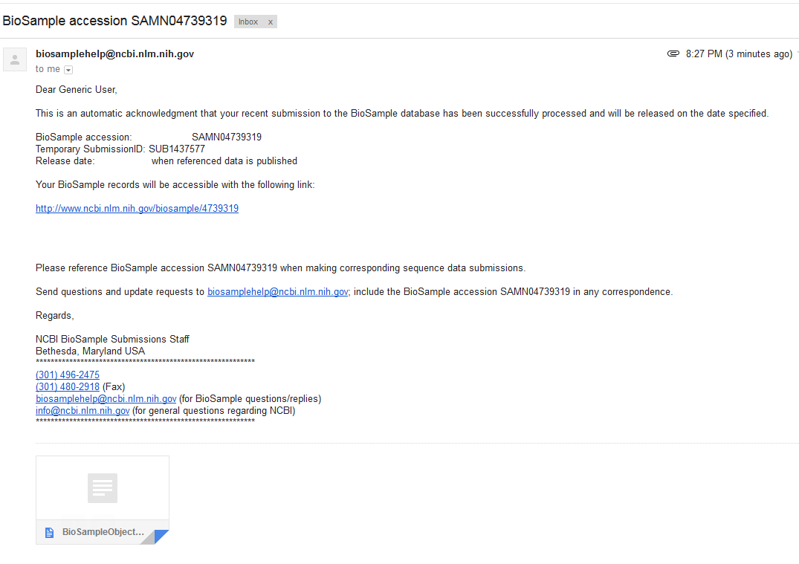
Notes:
When the record is processed, you will receive an email like this, with the BioSample accession number
Have this opened in a tab to show.

Slide 48
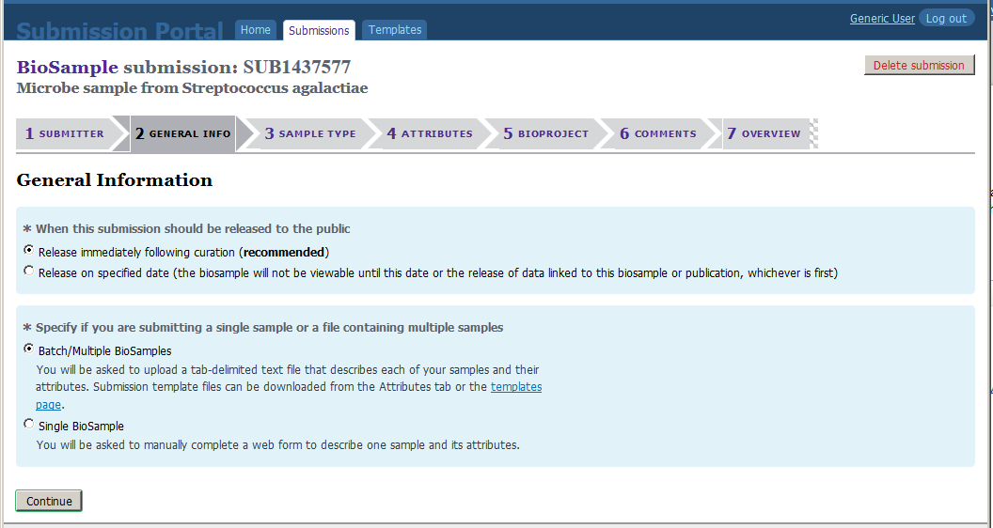
Notes:
This time choose Batch

Slide 49
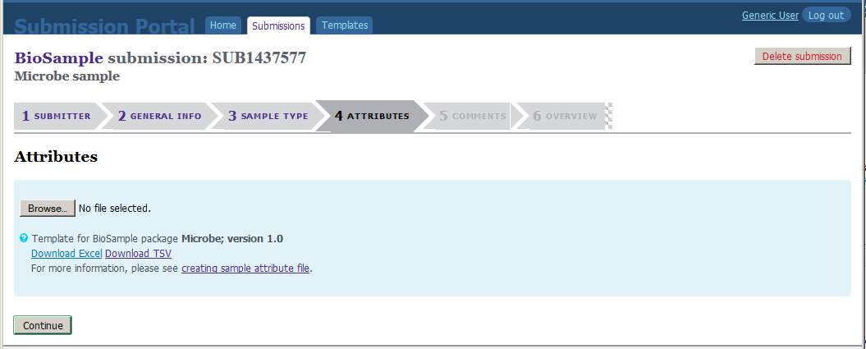
Notes:
First download the template in Excel
Show empty file –
Have MY_upload_template_good.xlsx open in Excel

Slide 50
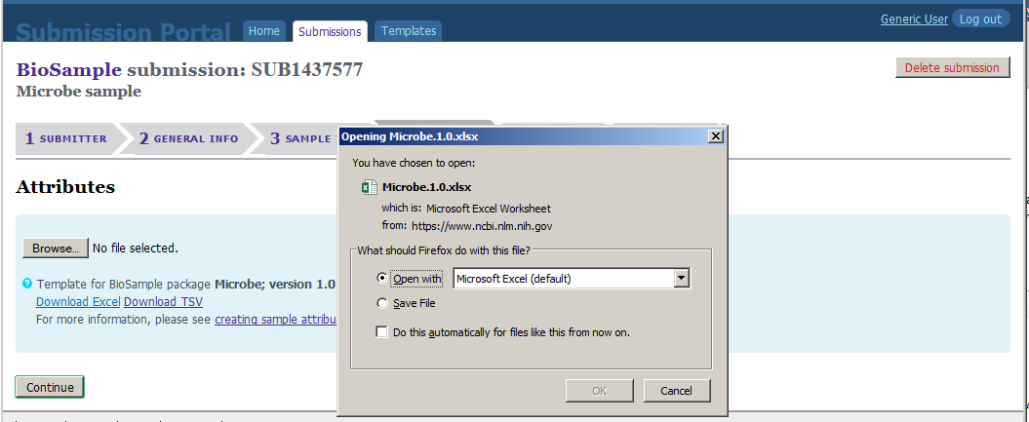
Notes:
Shows download

Slide 51
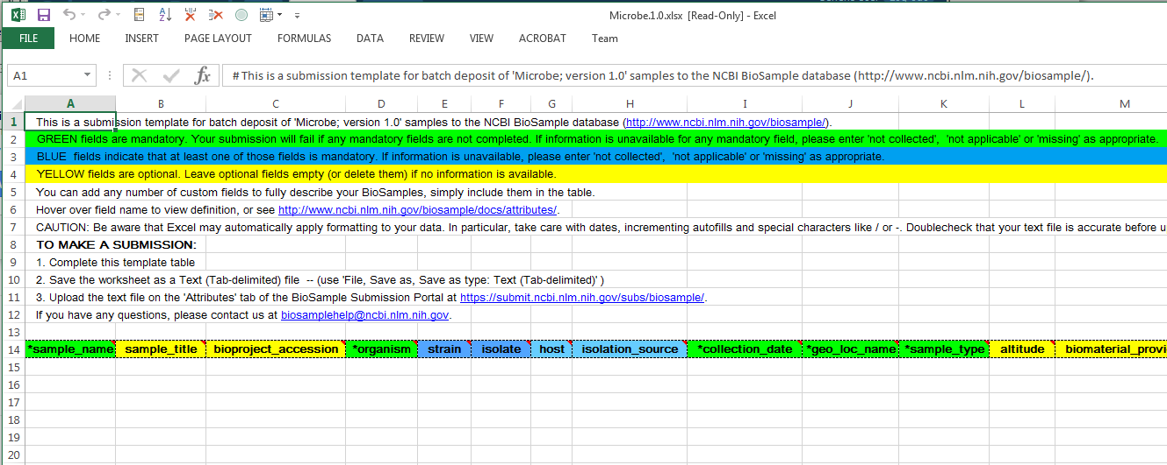
Notes:
Shows template in Excel for Microbe.
Point out instructions and color scheme.

Slide 52
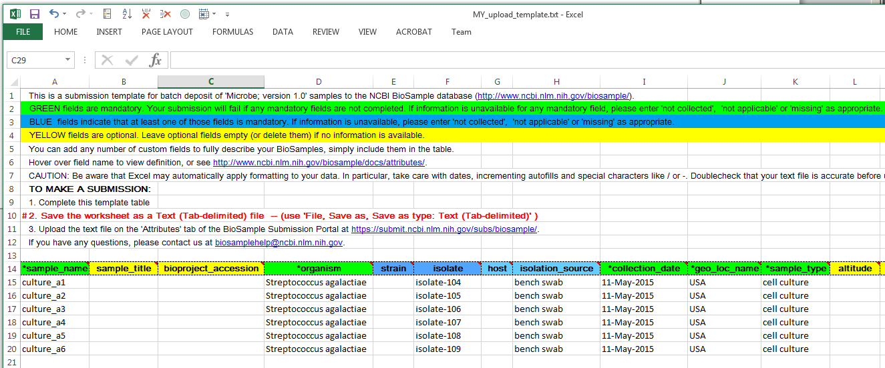
Notes:
Example of a file that will work.
Highlight that you must save as tab-delimited text to upload.

Slide 53
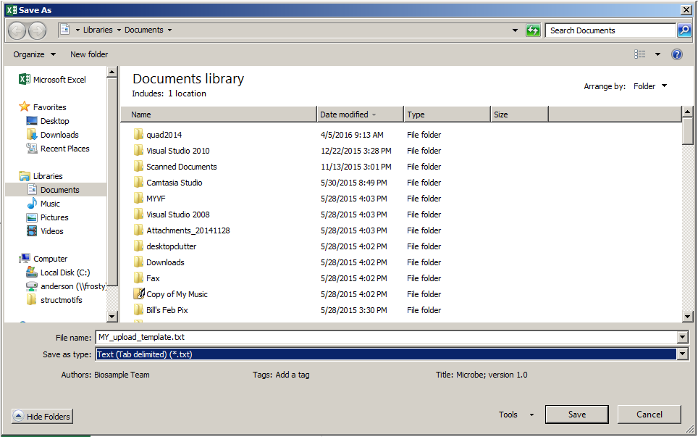
Notes:
Show tab-delimited choice in Excel in Windows – may look different in other systems

Slide 54

Notes:
Then Browse to upload

Slide 55
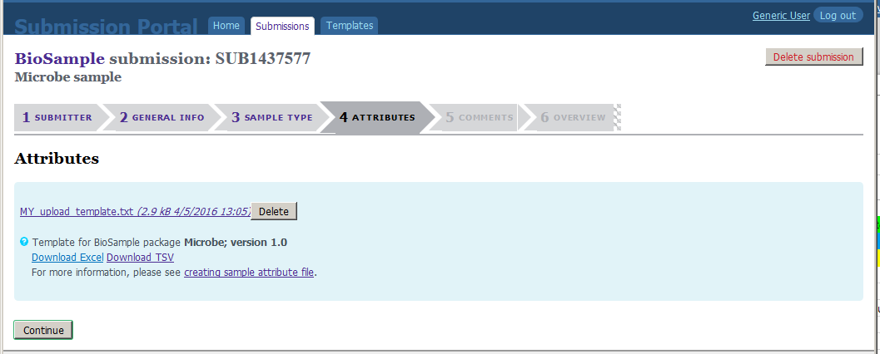
Notes:
File chosen, click Continue

Slide 56
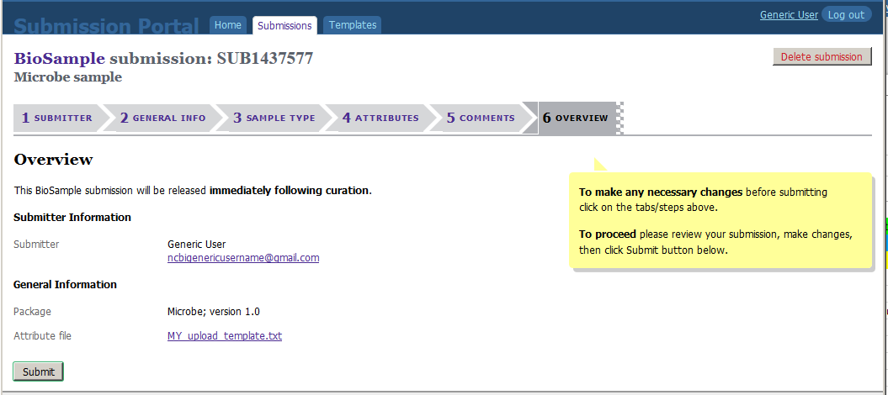
Notes:
Go on to overview page. Click Submit to complete submission.

Slide 57
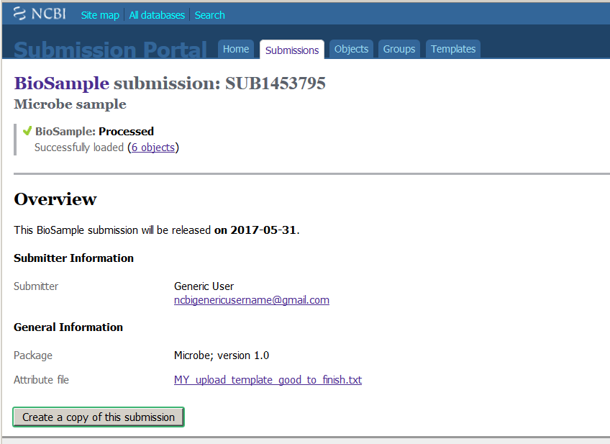
Web Submission Overview Page
Notes:
Go on to overview page. Click Submit to complete submission.
Once processing is done, the page looks like this

Slide 58
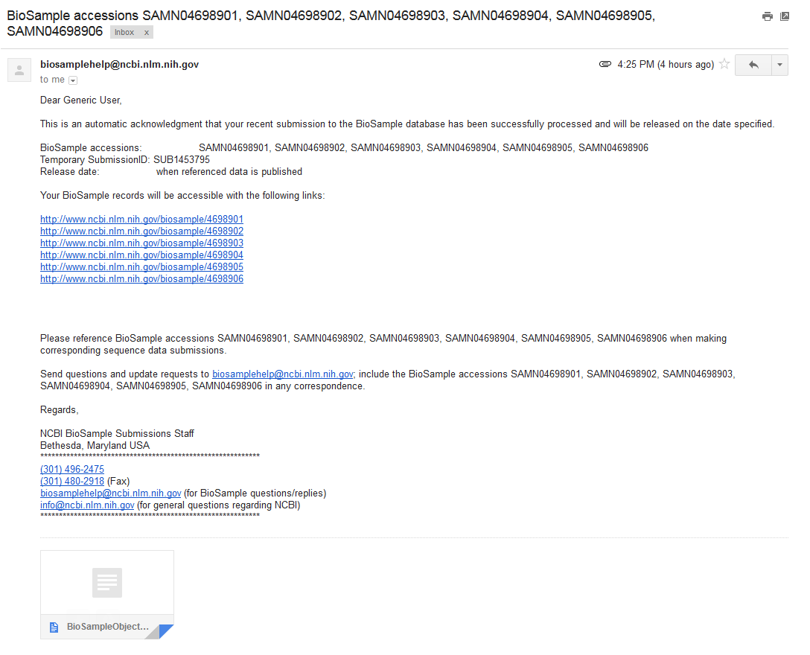
Letter Sent after Submission is Done
Notes:
This is the notification letter for a batch submission – looks a little different.
If there are too many to list, then the attached file has the accessions.

Slide 59
Error Messages

Slide 60
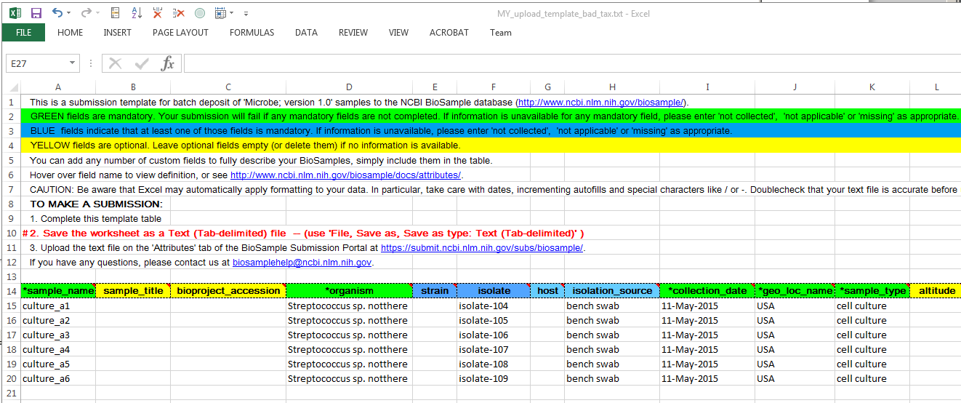
Organism Not Found
Notes:
Common mistakes
Bad organism name entered in table.

Slide 61
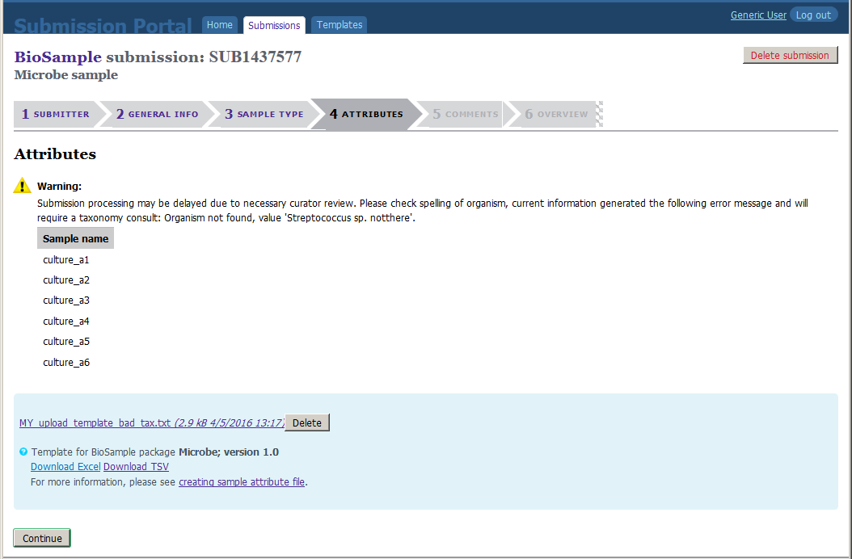
Web Page Error Message – Organism Not Found
Notes:
Bad organism name gets this warning.
It’s a warning to allow for new species, or ones that just aren’t in our taxonomy database yet.
Check for spelling errors if it should be in Tax. If it is right, you can proceed.
Bad organism triggers automatic curator review.
This can add a day to the processing time.

Slide 62
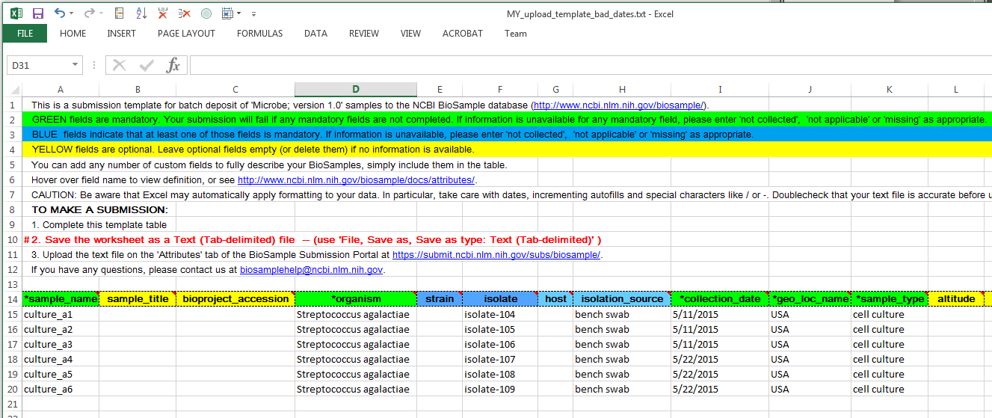
Bad Date Format
Notes:
Bad date format is one example for formatting errors.
It is also common for
geo_loc_name
lat_lon
to have formatting problems.

Slide 63
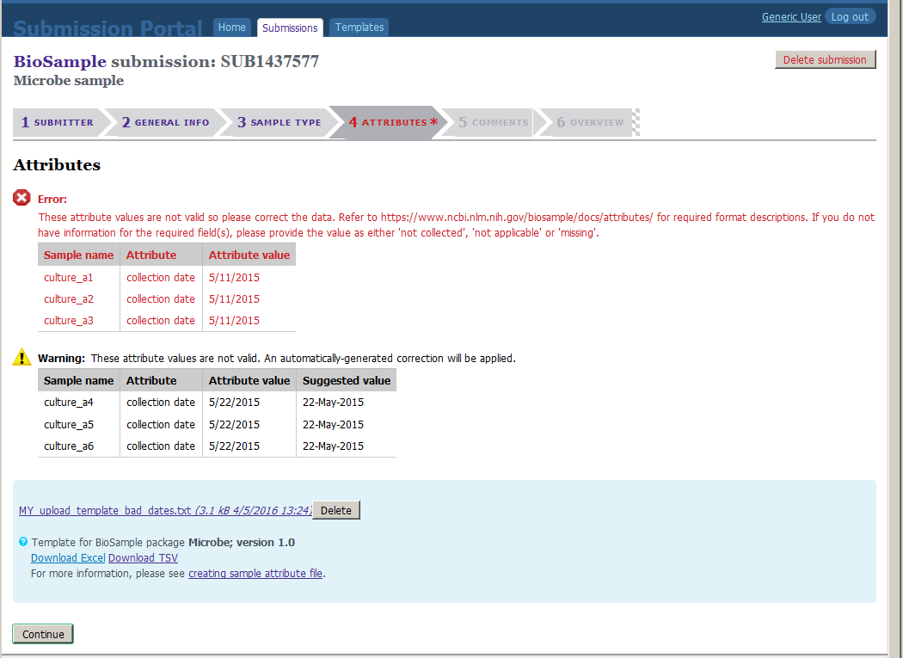
Web Page Error – Bad Date Format
Notes:
Ambiguous gets Error and submitter must correct to proceed.
5/11/2015 could be May 11, 2015 OR November 5, 2015.
The 5/22 entry gets a warning instead
Unambiguous dates will get autofix
5/22/2015 is obviously May 22, 2015

Slide 64
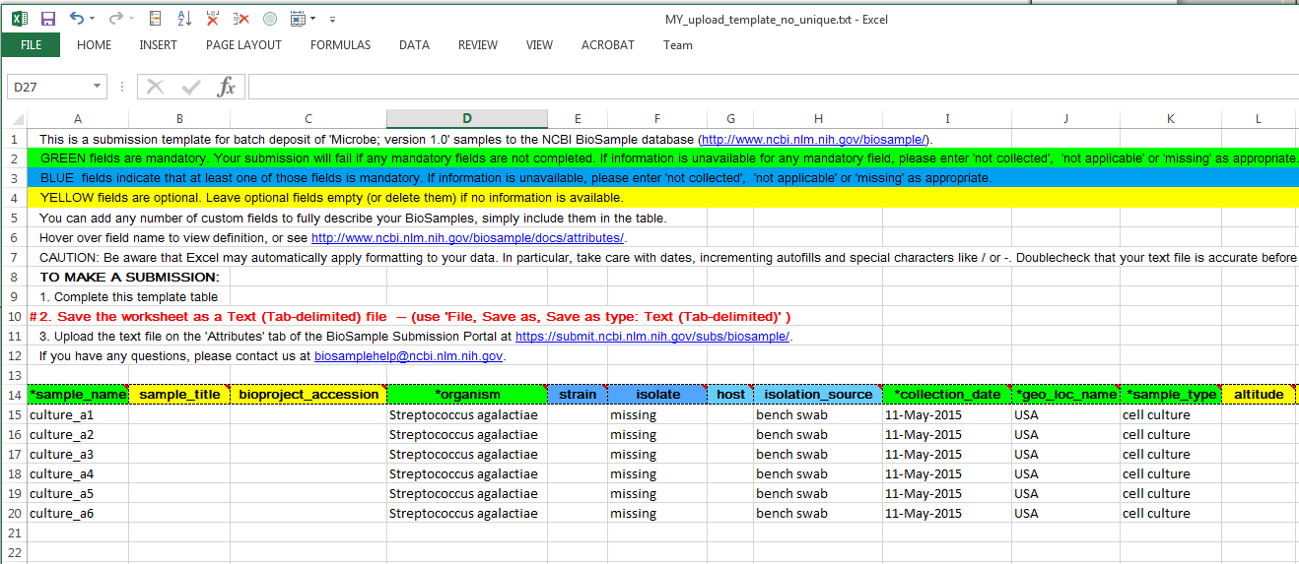
No Unique Information
Notes:
Here’s a file where everything except the sample_name is the same.

Slide 65
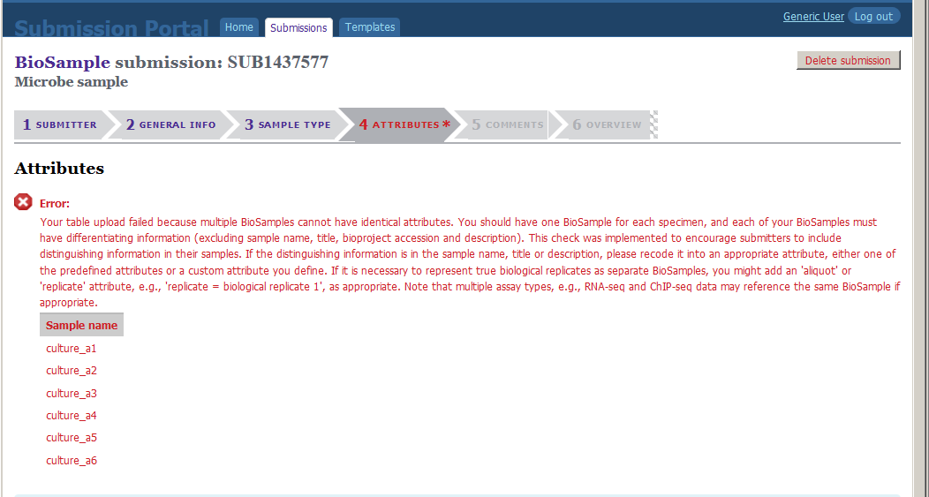
Web Page Error – No Unique Information
Notes:
The error message indicates that the problem with the submission file is that the information in some of the rows (ignoring sample name, sample title, and description, as the error message said), is identical.
This check was implemented to encourage submitters to include distinguishing metadata in their samples. Information in sample_name, description and title are not considered because the free text is not part of the controlled vocabulary.
The sample names are listed only to indicate which rows have the error.

Slide 66
Summary
Introduction
  What is a BioSample
Submission of a single record
  Attributes
Batch submission
  Templates
Error Messages
Notes:
Today I’d like to introduce you to the biosamples database and explain some of the concepts
And then take you through a demonstration of a couple of actual submissions

Slide 67
Additional Resources
Videos and Recordings <youtube>/ncbinlm
Documentation and Help
  BioSample Help <ncbi>/biosample/docs/submission/faq/
  NCBI Factsheets <ftp>/pub/factsheets/README_factsheets
  NCBI Help Desk info@ncbi.nlm.nih.gov
  Webinars webinars@ncbi.nlm.nih.gov
  BioSample biosamplehelp@ncbi.nlm.nih.gov

Slide 68
Questions?

Slide 69
Submitting BioSamples to NCBI
https://submit.ncbi.nlm.nih.gov/subs/biosample/

